Slide 1
Introduction to Neural Networks
Basics and Learning with Back propagation

Slide 2
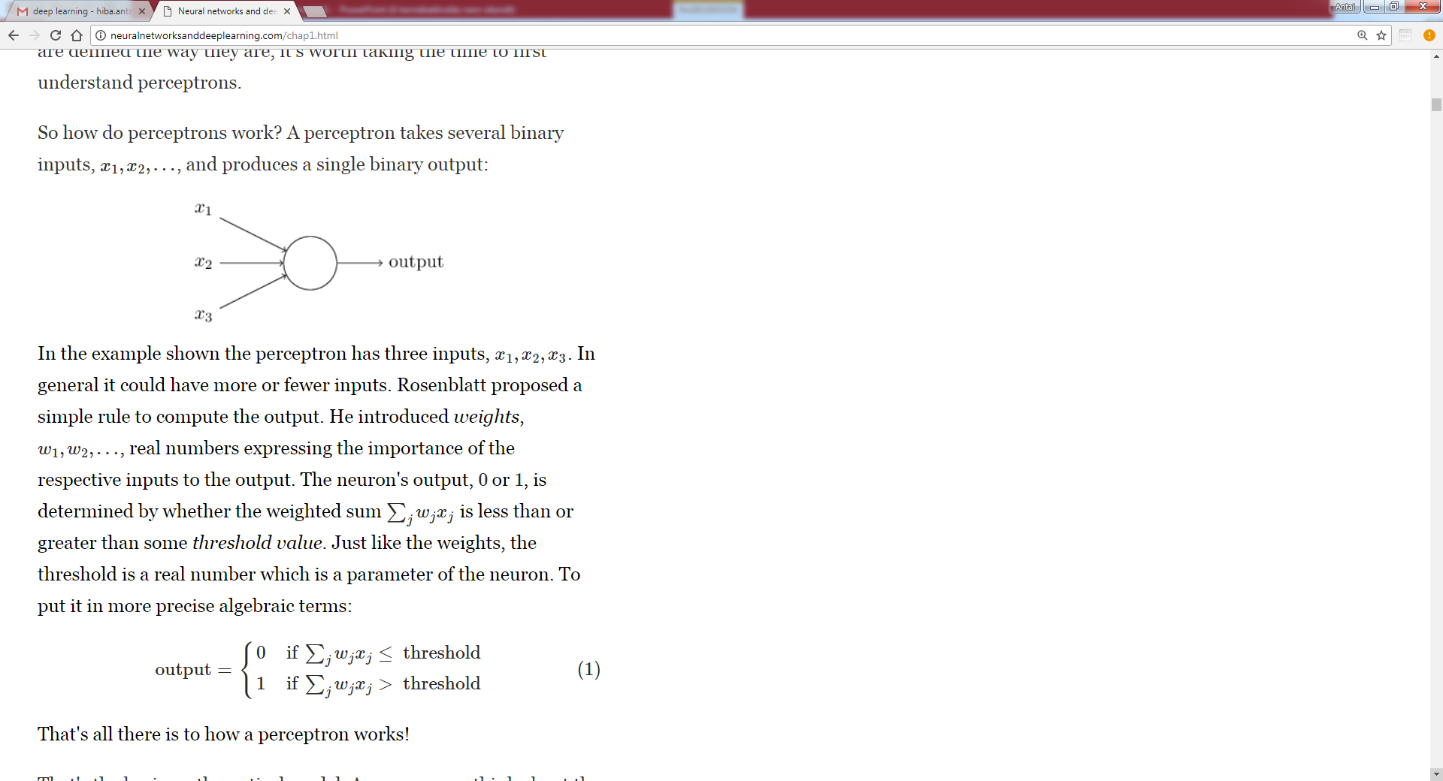
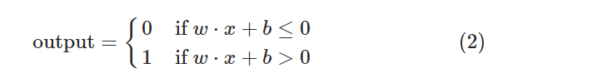
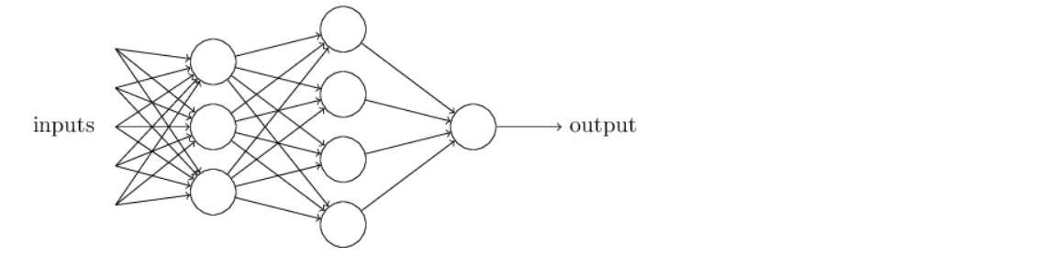
Perceptrons
neuralnetworksanddeeplearning.com Michael Nielsen

Slide 3
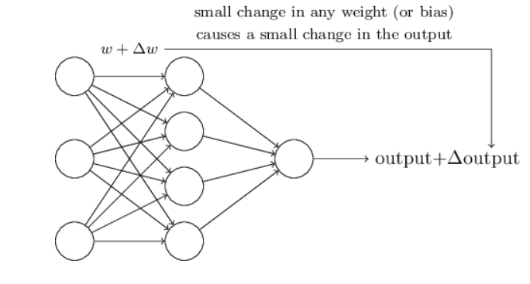
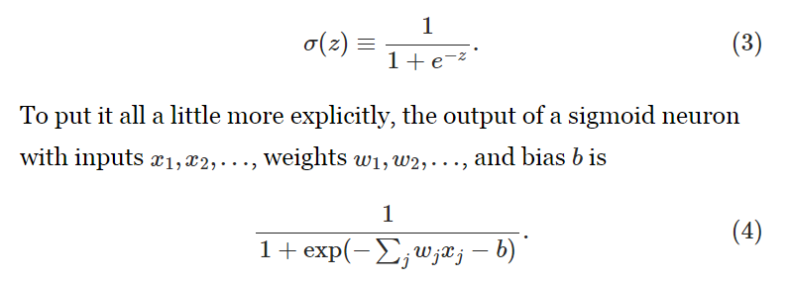
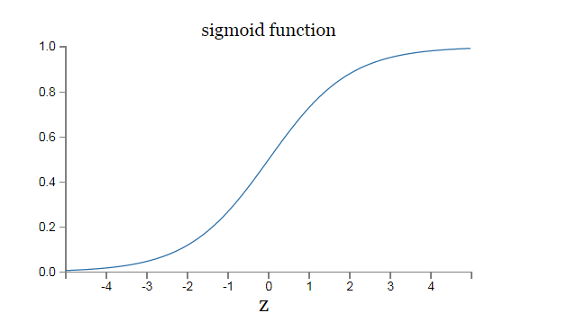
Sigmoid neurons
neuralnetworksanddeeplearning.com Michael Nielsen

Slide 4
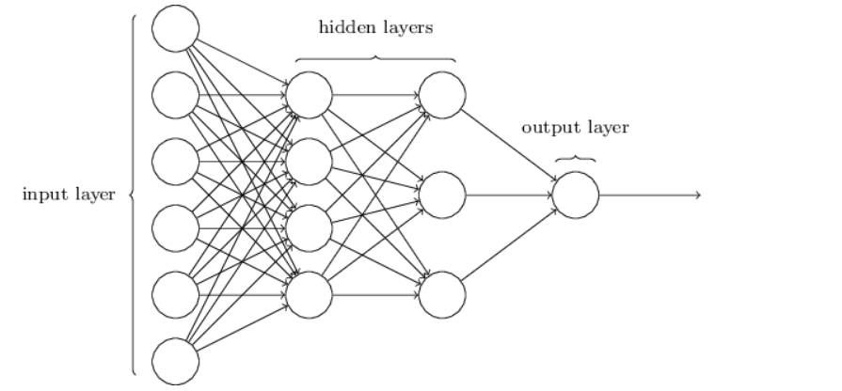
Architecture
Feedforward Neural network: No Loops information is fed forward
Recurrent neural network: loops are possible however, neurons output affects its input at some later time.
neuralnetworksanddeeplearning.com Michael Nielsen

Slide 5
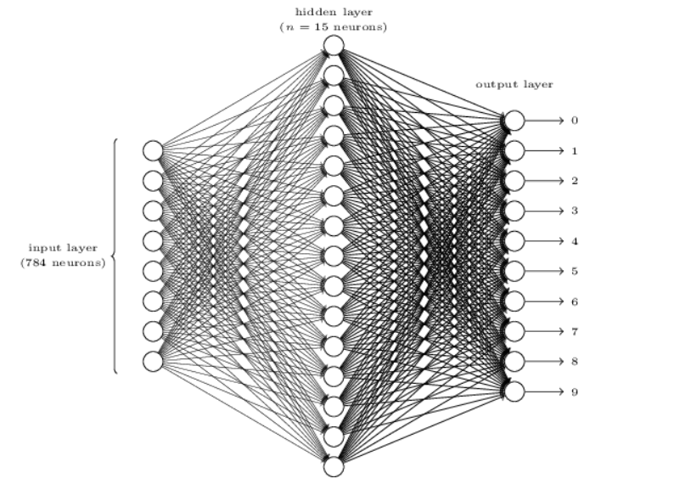
Example: recognising handwritten digits on 28x28 images
Output Y(x)
Y(x)=[0 0 0 0 0 0 1 0 0 0]^{T} => 6 with 1 confidence.
neuralnetworksanddeeplearning.com Michael Nielsen

Slide 6
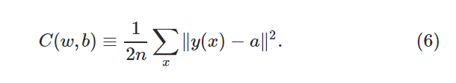
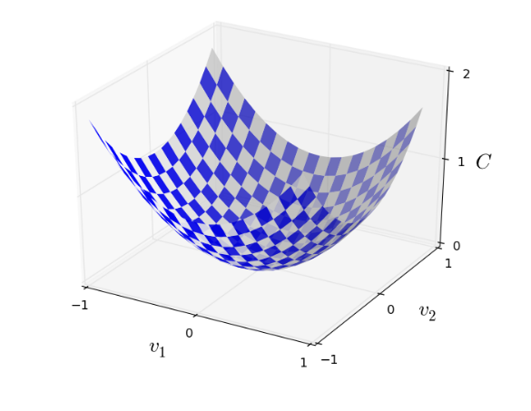
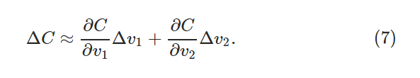
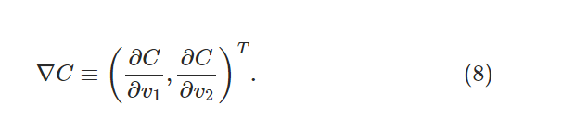
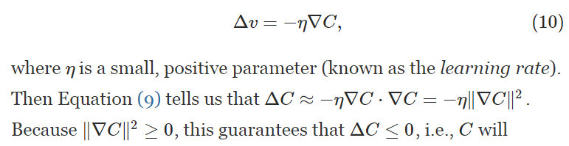
Training weights with optimization,
Gradient Descent
C(w,b) cost function.
a is the output of the net for input x and it also depends on w and b.
neuralnetworksanddeeplearning.com Michael Nielsen

Slide 7
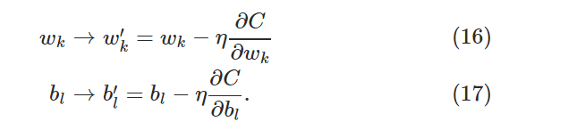
Apply Gradient descent to neural network
It has to be calculated for all training examples, which is too time consuming.
How to compute the gradient of the cost function?
Stohastic Gradient Descent: Use only a randomly selected subset (mini batch) of the training data to estimate the gradient.
We choose from the rest training data in the next steps until the training set is exhausted. It is called a complete epoch.
Training requires multiple epochs.
neuralnetworksanddeeplearning.com Michael Nielsen

Slide 8
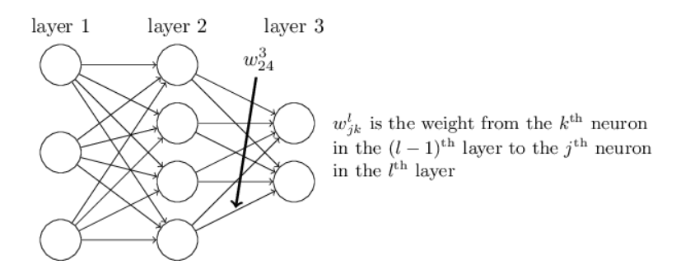
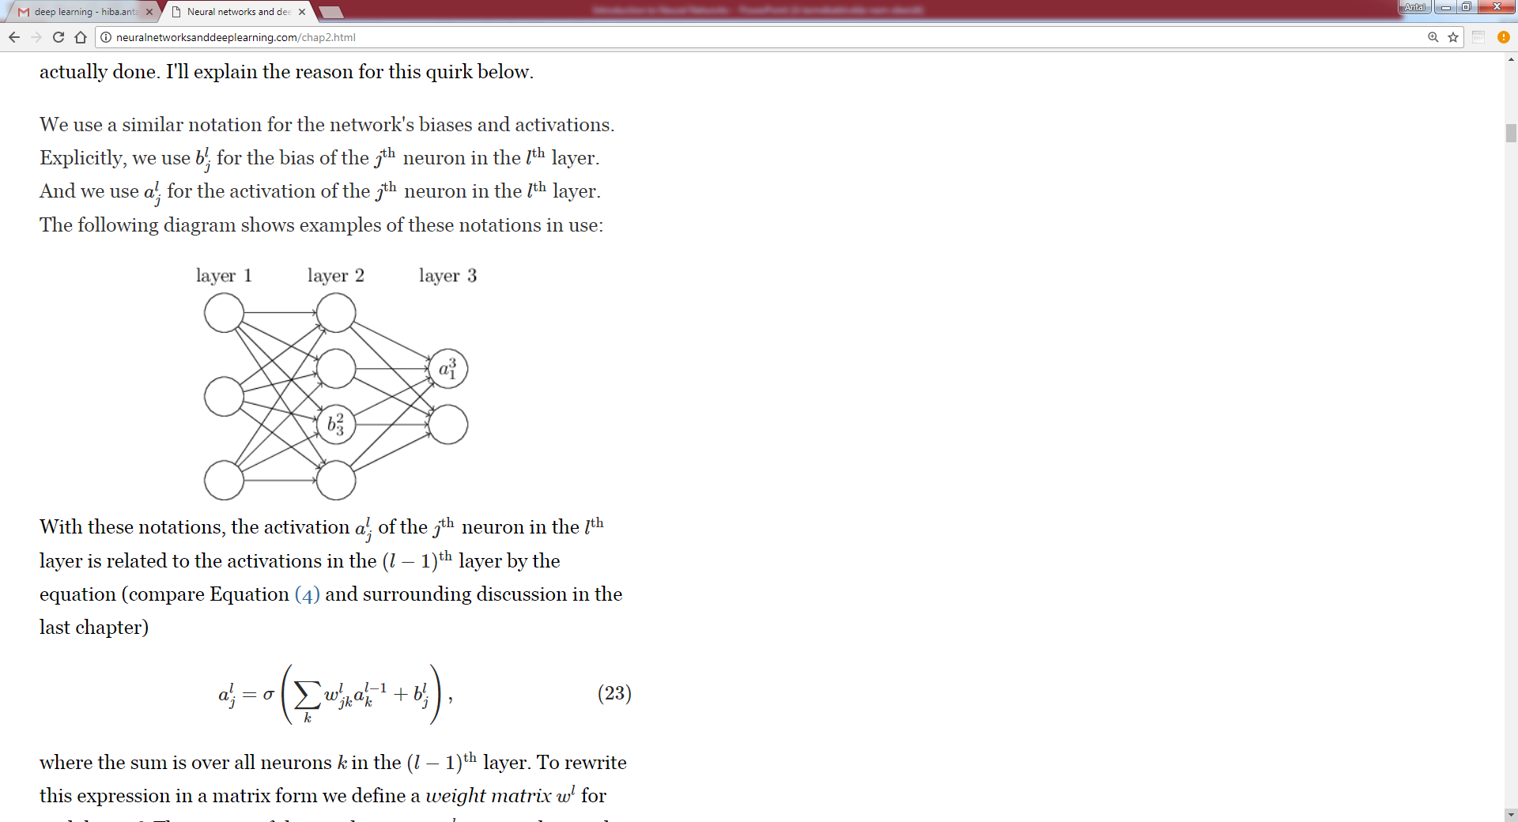
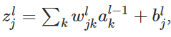
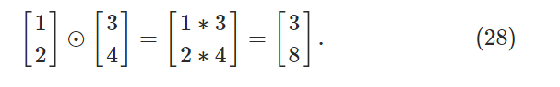
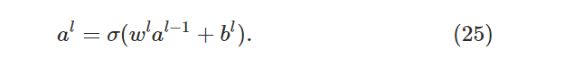
Backpropagation Algorithm - Notations
Hadamard product
neuralnetworksanddeeplearning.com Michael Nielsen

Slide 9
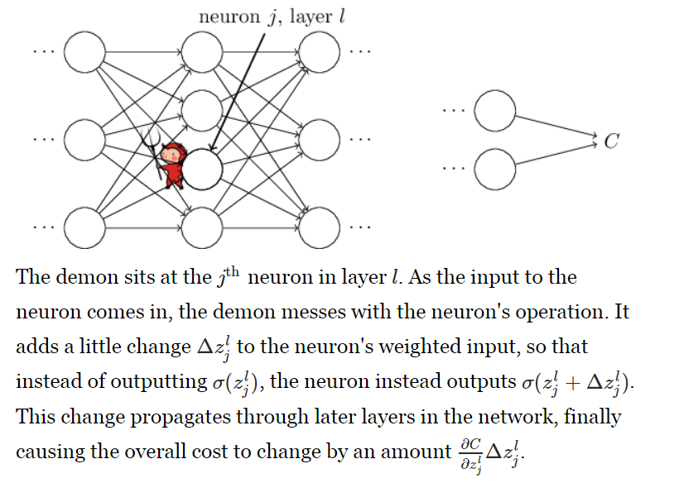
Effect of changing weights
neuralnetworksanddeeplearning.com Michael Nielsen

Slide 10
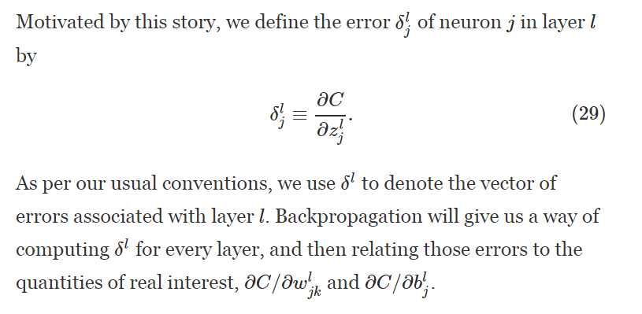
Effect of changing weights
neuralnetworksanddeeplearning.com Michael Nielsen

Slide 11
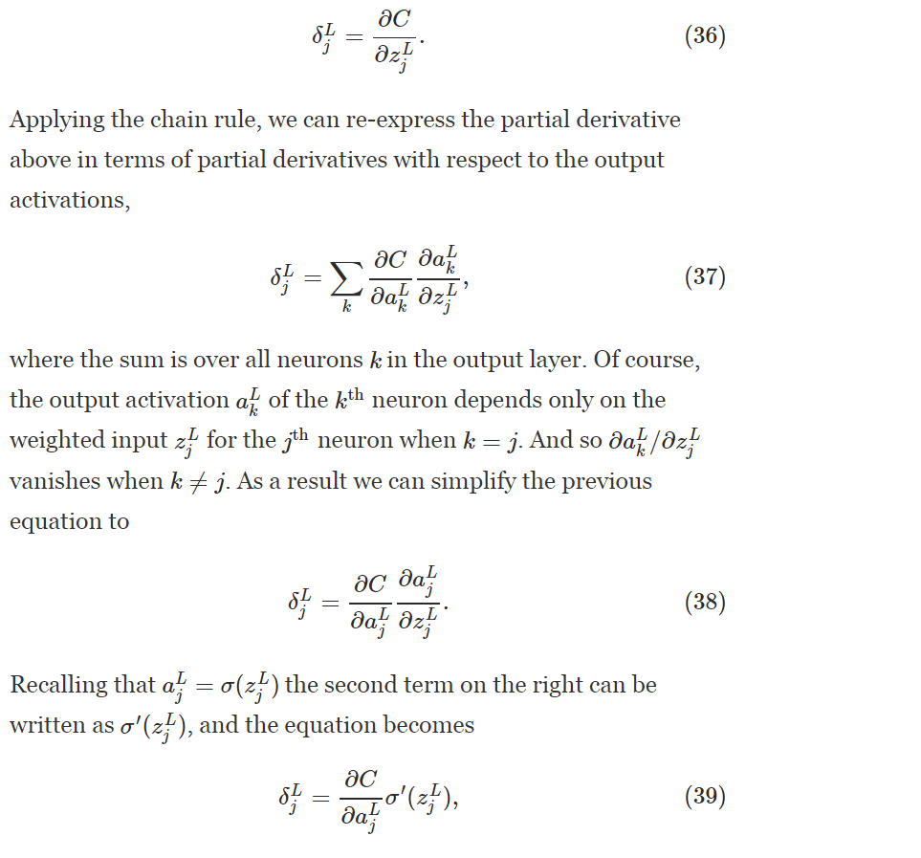
neuralnetworksanddeeplearning.com Michael Nielsen

Slide 12
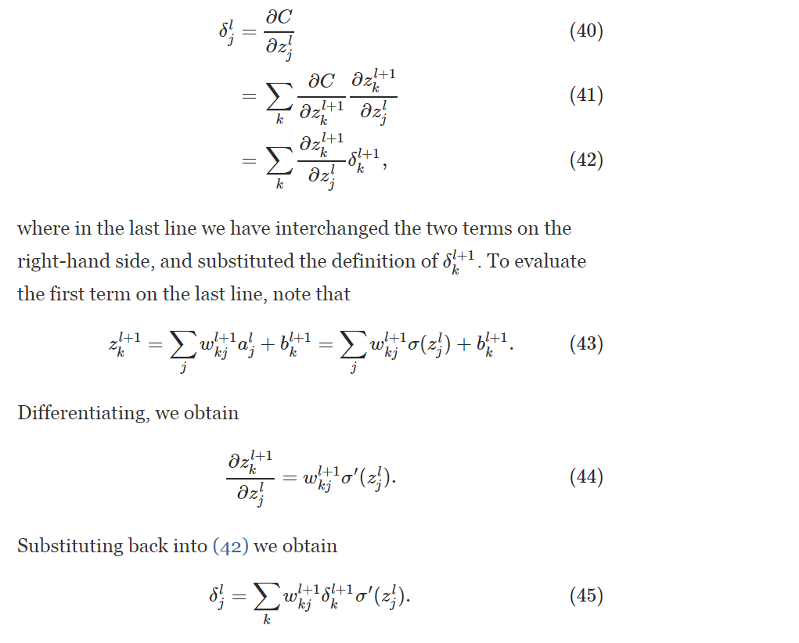
Propagating the error back
neuralnetworksanddeeplearning.com Michael Nielsen

Slide 13
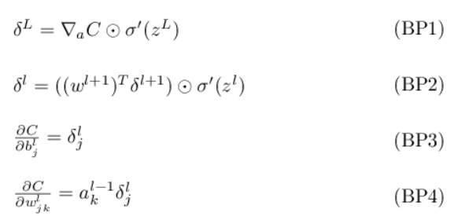
Summary of backpropagation
neuralnetworksanddeeplearning.com Michael Nielsen

Slide 14
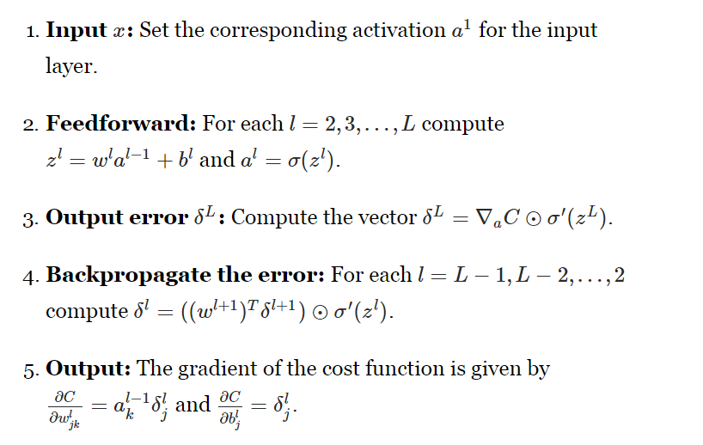

Slide 15
