Slide 1
BASIC METHODS 2

Slide 2
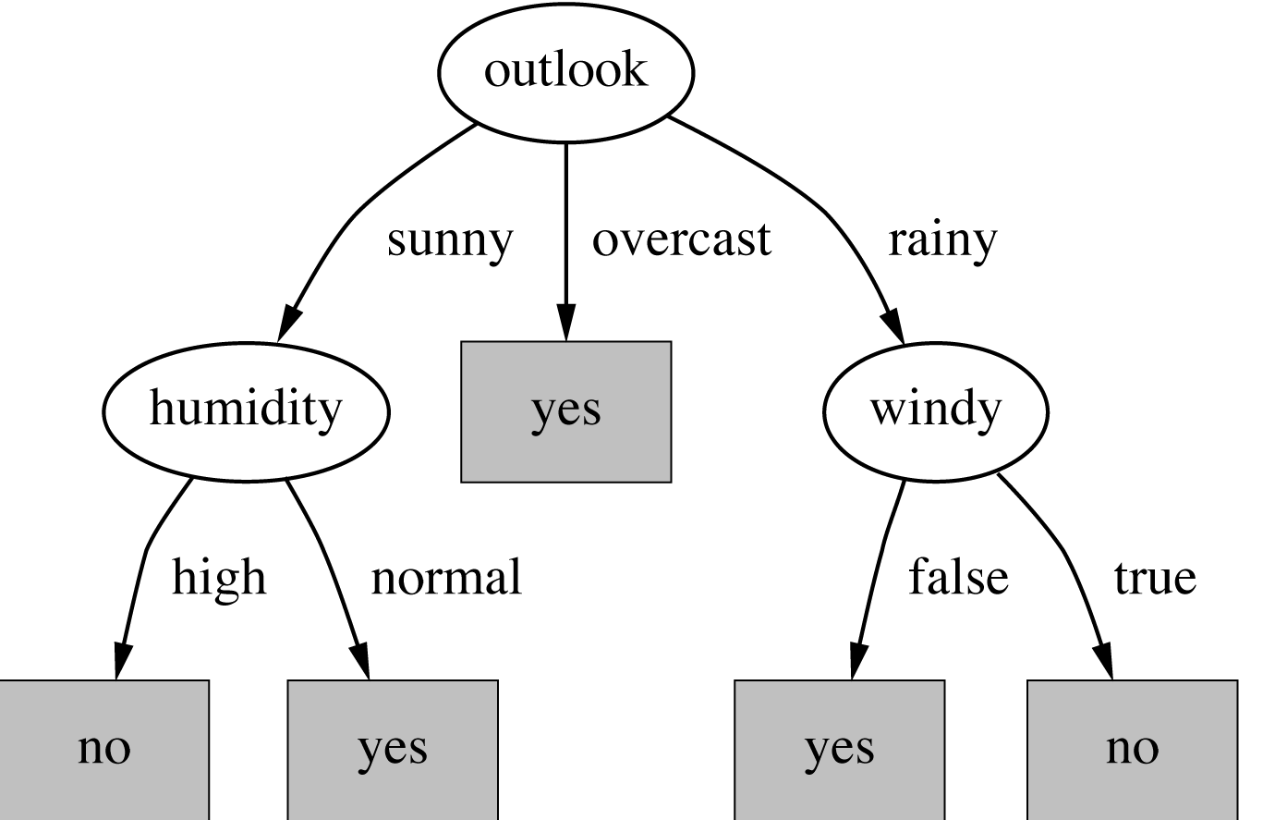
Decision trees
Classification and regression trees (categorical & numerical data handling)
Splits dataset into small subsets, final result: tree with
decision nodes: branches
leaf nodes: represents a classification
Which feature splits the data better (which is the best attribute)?

Slide 3
ID3 (Iterative Dichotomiser 3)
Core algorithm for building decision trees
Top-down, greedy search to test each attribute at every node of the tree
Which is the best attribute?
Information gain is used to construct a tree
Bet attribute: gives maximum IG / minimum entropy
Entropy: measure of randomness
Unbiased coin toss (head and tail is equally likely): E = 1
Biased (2 head): E = 0
ID3 uses entropy to calculate the homogeneity of a sample
Notes:
Unbiased coin toss: every state has the same probability
Biased coin toss: the outcome is sure (no randomness) >> we can classify the best our data >> the IG is maximal

Slide 4
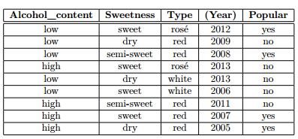
Wine dataset
IG: [information before splitting] – [information after splitting]
Calculate for each attribute

Slide 5

Alcohol_content
Information before splitting:
Info[4,5] = entropy(4/9,5/9)

Slide 6
Alcohol_content
Information before splitting:
Info[4,5] = entropy(4/9,5/9) = -4/9

Slide 7
Alcohol_content
Information before splitting:
Info[4,5] = entropy(4/9,5/9) = -4/9*log(4/9)

Slide 8
Alcohol_content
Information before splitting:
Info[4,5] = entropy(4/9,5/9) = -4/9*log(4/9) – 5/9

Slide 9
Alcohol_content
Information before splitting:
Info[4,5] = entropy(4/9,5/9) = -4/9*log(4/9) – 5/9*log(5/9)

Slide 10
Alcohol_content
Information before splitting:
Info[4,5] = entropy(4/9,5/9) = -4/9*log(4/9) – 5/9*log(5/9)

Slide 11
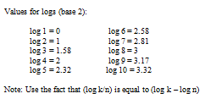
Alcohol_content
Information before splitting:
Info[4,5] = entropy(4/9,5/9) = -4/9*log(4/9) – 5/9*log(5/9)

Slide 12
Alcohol_content
Information before splitting:
Info[4,5] = entropy(4/9,5/9) = -4/9*log(4/9) – 5/9*log(5/9) =
= -4/9 * (2-3.17) – 5/9 * (2.32-3.17)

Slide 13
Alcohol_content
Information before splitting:
Info[4,5] = entropy(4/9,5/9) = -4/9*log(4/9) – 5/9*log(5/9) =
= -4/9 * (2-3.17) – 5/9 * (2.32-3.17) = 0.99

Slide 14
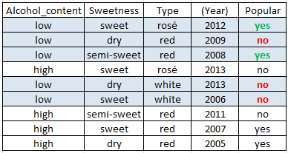
Alcohol_content
Alcohol_content = low:

Slide 15
Alcohol_content
Alcohol_content = low:
Info([2,3]) = entropy(2/5,3/5)=

Slide 16
Alcohol_content
Alcohol_content = low:
Info([2,3]) = entropy(2/5,3/5)= -2/5log(2/5)-3/5log(3/5)=0.972 bits

Slide 17
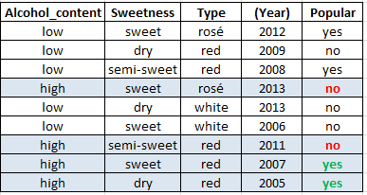
Alcohol_content
Alcohol_content = low:
Info([2,3]) = entropy(2/5,3/5)= -2/5log(2/5)-3/5log(3/5)=0.972 bits
Alcohol_content = high:

Slide 18
Alcohol_content
Alcohol_content = low:
Info([2,3]) = entropy(2/5,3/5)= -2/5log(2/5)-3/5log(3/5)=0.972 bits
Alcohol_content = high:
Info([2,2]) = entropy(2/4,2/4)=

Slide 19
Alcohol_content
Alcohol_content = low:
Info([2,3]) = entropy(2/5,3/5)= -2/5log(2/5)-3/5log(3/5)=0.972 bits
Alcohol_content = high:
Info([2,2]) = entropy(2/4,2/4)= -2/4log(2/4)-2/4log(2/4)=1 bits

Slide 20
Alcohol_content
Alcohol_content = low:
Info([2,3]) = entropy(2/5,3/5)= -2/5log(2/5)-3/5log(3/5)=0.972 bits
Alcohol_content = high:
Info([2,2]) = entropy(2/4,2/4)= -2/4log(2/4)-2/4log(2/4)=1 bits
Expected information for attribute:
Info([2,3], [2,2]) =

Slide 21
Alcohol_content
Alcohol_content = low:
Info([2,3]) = entropy(2/5,3/5)= -2/5log(2/5)-3/5log(3/5)=0.972 bits
Alcohol_content = high:
Info([2,2]) = entropy(2/4,2/4)= -2/4log(2/4)-2/4log(2/4)=1 bits
Expected information for attribute:
Info([2,3], [2,2]) = 5/9 * 0.972 + 4/9 * 1 = 0.98 bits

Slide 22
Alcohol_content
Alcohol_content = low:
Info([2,3]) = entropy(2/5,3/5)= -2/5log(2/5)-3/5log(3/5)=0.972 bits
Alcohol_content = high:
Info([2,2]) = entropy(2/4,2/4)= -2/4log(2/4)-2/4log(2/4)=1 bits
Expected information for attribute:
Info([2,3], [2,2]) = 5/9 * 0.972 + 4/9 * 1 = 0.98 bits
Information gain: information before splitting – information after splitting

Slide 23
Alcohol_content
Alcohol_content = low:
Info([2,3]) = entropy(2/5,3/5)= -2/5log(2/5)-3/5log(3/5)=0.972 bits
Alcohol_content = high:
Info([2,2]) = entropy(2/4,2/4)= -2/4log(2/4)-2/4log(2/4)=1 bits
Expected information for attribute:
Info([2,3], [2,2]) = 5/9 * 0.972 + 4/9 * 1 = 0.98 bits
Information gain: information before splitting – information after splitting
gain(Alcohol_content ) =

Slide 24
Alcohol_content
Alcohol_content = low:
Info([2,3]) = entropy(2/5,3/5)= -2/5log(2/5)-3/5log(3/5)=0.972 bits
Alcohol_content = high:
Info([2,2]) = entropy(2/4,2/4)= -2/4log(2/4)-2/4log(2/4)=1 bits
Expected information for attribute:
Info([2,3], [2,2]) = 5/9 * 0.972 + 4/9 * 1 = 0.98 bits
Information gain: information before splitting – information after splitting
gain(Alcohol_content ) = info([4,5]) – info([2,3],[2,2])

Slide 25
Alcohol_content
Alcohol_content = low:
Info([2,3]) = entropy(2/5,3/5)= -2/5log(2/5)-3/5log(3/5)=0.972 bits
Alcohol_content = high:
Info([2,2]) = entropy(2/4,2/4)= -2/4log(2/4)-2/4log(2/4)=1 bits
Expected information for attribute:
Info([2,3], [2,2]) = 5/9 * 0.972 + 4/9 * 1 = 0.98 bits
Information gain: information before splitting – information after splitting
gain(Alcohol_content ) = info([4,5]) – info([2,3],[2,2]) = 0.99 – 0.98 = 0.01 bits

Slide 26
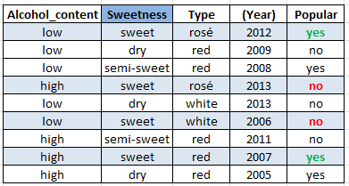
Sweetness
Sweetness = sweet:

Slide 27
Sweetness
Sweetness = sweet:
Info([2,2]) = entropy(2/4,2/4)=

Slide 28
Sweetness
Sweetness = sweet:
Info([2,2]) = entropy(2/4,2/4)= -2/4 log(2/4)-2/4log(2/4) = 1 bits

Slide 29
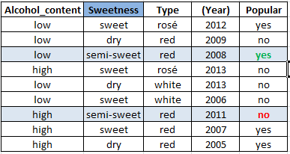
Sweetness
Sweetness = sweet:
Info([2,2]) = entropy(2/4,2/4)= -2/4 log(2/4)-2/4log(2/4) = 1 bits
Sweetness = semi-sweet

Slide 30
Sweetness
Sweetness = sweet:
Info([2,2]) = entropy(2/4,2/4)= -2/4 log(2/4)-2/4log(2/4) = 1 bits
Sweetness = semi-sweet
Info([1,1]) = entropy(1/2,1/2)= -1/2 log(1/2)-1/2log(1/2) = 1 bits

Slide 31
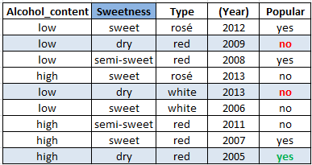
Sweetness
Sweetness = sweet:
Info([2,2]) = entropy(2/4,2/4)= -2/4 log(2/4)-2/4log(2/4) = 1 bits
Sweetness = semi-sweet
Info([1,1]) = entropy(1/2,1/2)= -1/2 log(1/2)-1/2log(1/2) = 1 bits
Sweetness = dry

Slide 32
Sweetness
Sweetness = sweet:
Info([2,2]) = entropy(2/4,2/4)= -2/4 log(2/4)-2/4log(2/4) = 1 bits
Sweetness = semi-sweet
Info([1,1]) = entropy(1/2,1/2)= -1/2 log(1/2)-1/2log(1/2) = 1 bits
Sweetness = dry
Info([1,2]) = entropy(1/3,2/3)= -1/3 log(1/3)-2/3log(2/3) = 0. 913 bits

Slide 33
Sweetness
Sweetness = sweet:
Info([2,2]) = entropy(2/4,2/4)= -2/4 log(2/4)-2/4log(2/4) = 1 bits
Sweetness = semi-sweet
Info([1,1]) = entropy(1/2,1/2)= -1/2 log(1/2)-1/2log(1/2) = 1 bits
Sweetness = dry
Info([1,2]) = entropy(1/3,2/3)= -1/3 log(1/3)-2/3log(2/3) = 0. 913 bits
Expected information for attribute:
Info([2,2], [1,1], [1,2]) = 4/9 * 1 + 2/9 * 1 + 3/9 *0.913 = 0.971 bits

Slide 34
Sweetness
Sweetness = sweet:
Info([2,2]) = entropy(2/4,2/4)= -2/4 log(2/4)-2/4log(2/4) = 1 bits
Sweetness = semi-sweet
Info([1,1]) = entropy(1/2,1/2)= -1/2 log(1/2)-1/2log(1/2) = 1 bits
Sweetness = dry
Info([1,2]) = entropy(1/3,2/3)= -1/3 log(1/3)-2/3log(2/3) = 0. 913 bits
Expected information for attribute:
Info([2,2], [1,1], [1,2]) = 4/9 * 1 + 2/9 * 1 + 3/9 *0.913 = 0.971 bits
Information gain: information before splitting – information after splitting
gain(Sweetness ) = info([4,5]) – info([2,2],[1,1],[1,2]) = 0.99 – 0.971 = 0.019 bits

Slide 35
Type
Type = rosé:
Type = red:
Type = white:
Expected information for attribute:
Information gain: information before splitting – information after splitting
gain(Type ) =

Slide 36
Type
Type = rosé:
Info([1,1]) = entropy(1/2,1/2)= -1/2 log(1/2)-1/2log(1/2) = 1 bits
Type = red:
Type = white:
Expected information for attribute:
Information gain: information before splitting – information after splitting
gain(Type) =

Slide 37
Type
Type = rosé:
Info([1,1]) = entropy(1/2,1/2)= -1/2 log(1/2)-1/2log(1/2) = 1 bits
Type = red:
Info([3,2]) = = entropy(3/5,2/5)= -3/5log(3/5)-2/5log(2/5)= 0.972
Type = white:
Expected information for attribute:
Information gain: information before splitting – information after splitting
gain(Type ) =

Slide 38
Type
Type = rosé:
Info([1,1]) = entropy(1/2,1/2)= -1/2 log(1/2)-1/2log(1/2) = 1 bits
Type = red:
Info([3,2]) = = entropy(3/5,2/5)= -3/5log(3/5)-2/5log(2/5)= 0.972
Type = white:
Info([0,2]) = entropy(0/2,2/2)= -0/2 log(0/2)-2/2log(2/2) = 0 bits
Expected information for attribute:
Information gain: information before splitting – information after splitting
gain(Type ) =

Slide 39
Type
Type = rosé:
Info([1,1]) = entropy(1/2,1/2)= -1/2 log(1/2)-1/2log(1/2) = 1 bits
Type = red:
Info([3,2]) = = entropy(3/5,2/5)= -3/5log(3/5)-2/5log(2/5)= 0.972
Type = white:
Info([0,2]) = entropy(0/2,2/2)= -0/2 log(0/2)-2/2log(2/2) = 0 bits
Expected information for attribute:
Info([1,1], [3,2], [0,2]) = 2/9 * 1 + 5/9 * 0.972 + 2/9 *0 = 0.762 bits
Information gain: information before splitting – information after splitting
gain(Type ) =

Slide 40
Type
Type = rosé:
Info([1,1]) = entropy(1/2,1/2)= -1/2 log(1/2)-1/2log(1/2) = 1 bits
Type = red:
Info([3,2]) = = entropy(3/5,2/5)= -3/5log(3/5)-2/5log(2/5)= 0.972
Type = white:
Info([0,2]) = entropy(0/2,2/2)= -0/2 log(0/2)-2/2log(2/2) = 0 bits
Expected information for attribute:
Info([1,1], [3,2], [0,2]) = 2/9 * 1 + 5/9 * 0.972 + 2/9 *0 = 0.762 bits
Information gain: information before splitting – information after splitting
gain(Type ) = info([4,5]) – info([1,1],[3,2],[0,2]) = 0.99 – 0.762 = 0.227 bits

Slide 41
Information gain
gain(Alcohol_content ) = 0.01 bits
gain(Sweetness ) = 0.019 bits
gain(Type ) = 0.227 bits

Slide 42
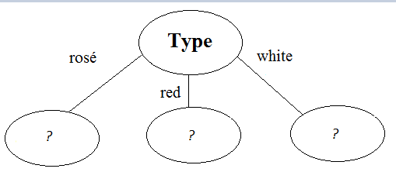
Information gain
gain(Alcohol_content ) = 0.01 bits
gain(Sweetness ) = 0.019 bits
gain(Type ) = 0.227 bits

Slide 43

Type = rosé
Information before splitting: Info[1,1] = 1 bits
Alcohol_content = low: Info([1,0]) = 0 bits
Alcohol_content = high: Info([0,1]) = 0 bits
Info([1,0], [0,1]) = 1/2 * 0 + 1/2 * 0 = 0 bits
gain(Alcohol_content ) = 1– 0 = 1 bits

Slide 44
Type = rosé
Information before splitting: Info[1,1] = 1 bits
Sweetness = sweet: Info([1,1]) = 1 bits
Sweetness = semi-sweet: Info([0,0]) = 0 bits Sweetness = dry: Info([0,0]) = 0 bits
Info([1,1], [0,0]),[0,0]) = 1 bits
gain(Sweetness ) = 1– 1 = 0 bits

Slide 45
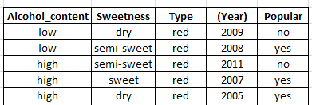
Type = red
Information before splitting: Info[3,2] =0.972 bits
Alcohol_content = low: Info([1,1]) = 1 bits
Alcohol_content = high: Info([2,1]) = 0.913 bits
Info([1,1], [2,1]) = 2/5 * 1 + 3/5 * 0.913 = 0.95 bits
gain(Alcohol_content ) = 0.972– 0.95 = 0.022 bits

Slide 46
Type = red
Information before splitting: Info[3,2] = 0.972 bits
Sweetness = sweet: Info([1,0]) = 0 bits
Sweetness = semi-sweet: Info([1,1]) = 1 bits Sweetness = dry: Info([1,1]) = 1 bits
Info([1,0], [1,1]),[1,1]) = 1/5*0 + 2/5 * 1 + 2/5 *1 = 0.8 bits
gain(Sweetness ) = 0.972– 0.8 = 0.172 bits

Slide 47

Type = white

Slide 48
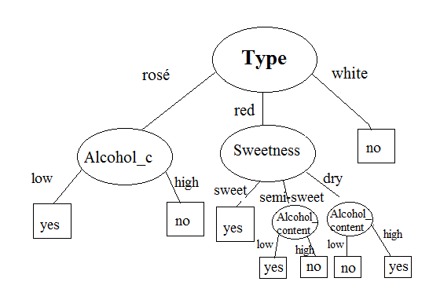

Slide 49
