Slide 1

Biomedical Signal Processing
Lab session 12
Márton Áron Goda

Slide 2
Overview
The heart conduction and propagation system
PCG measurement
Normal and abnormal heartsounds
Advanced techniques for PCG analysis
Practice

Slide 3
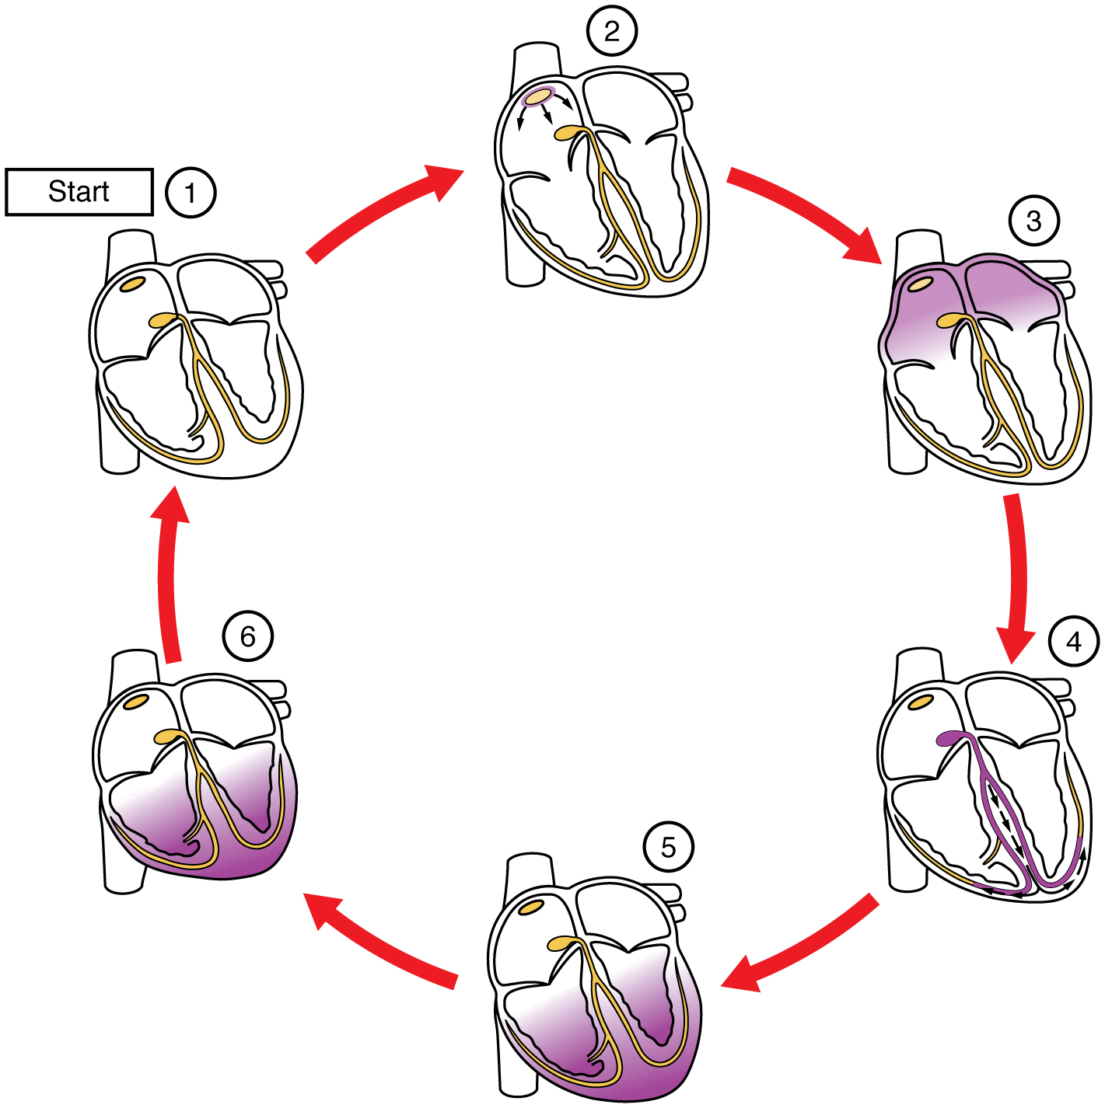
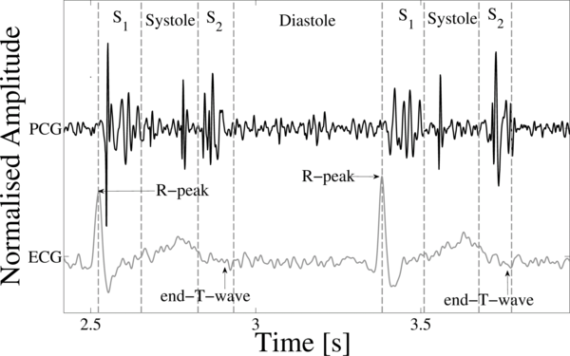
The heart conduction and propagation system

Slide 4
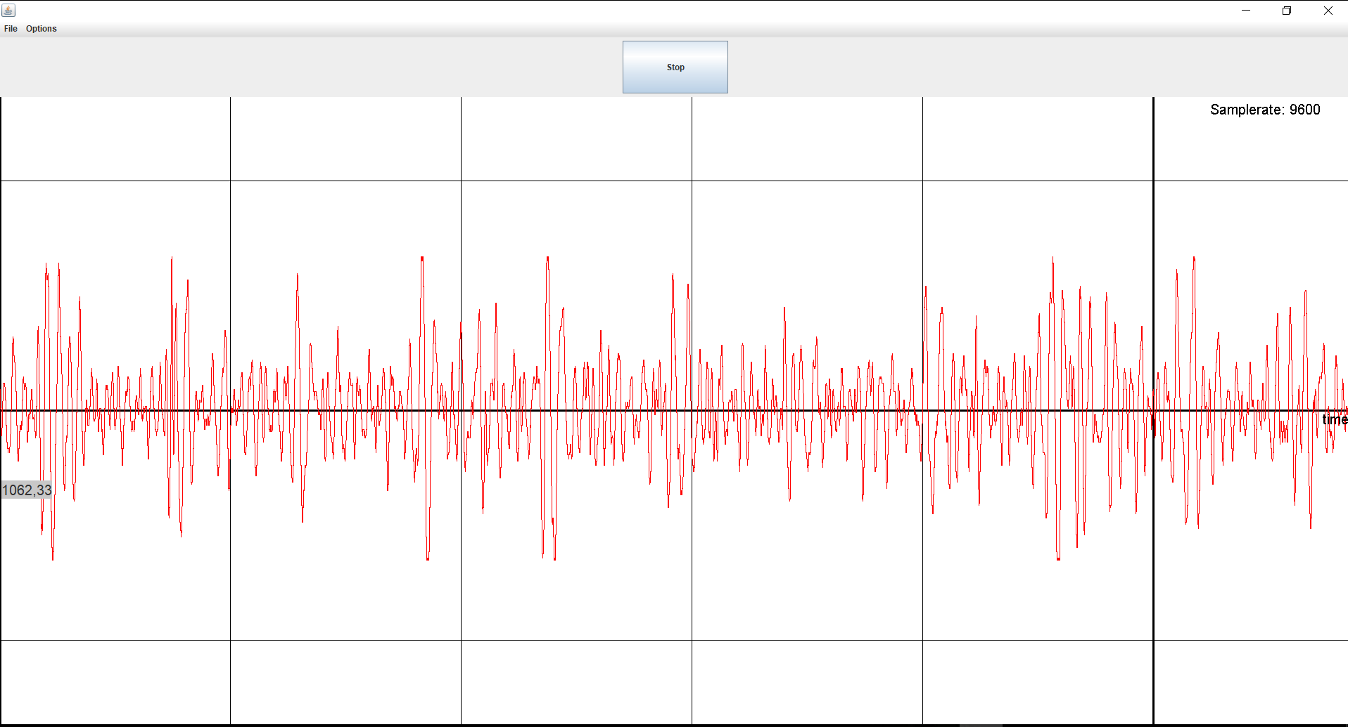
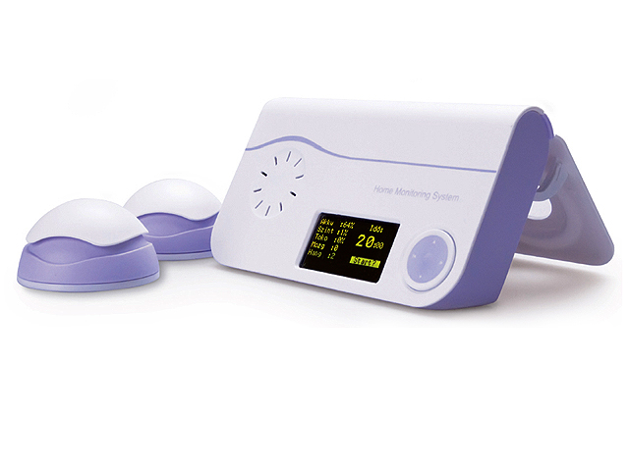
PCG measurement

Slide 5
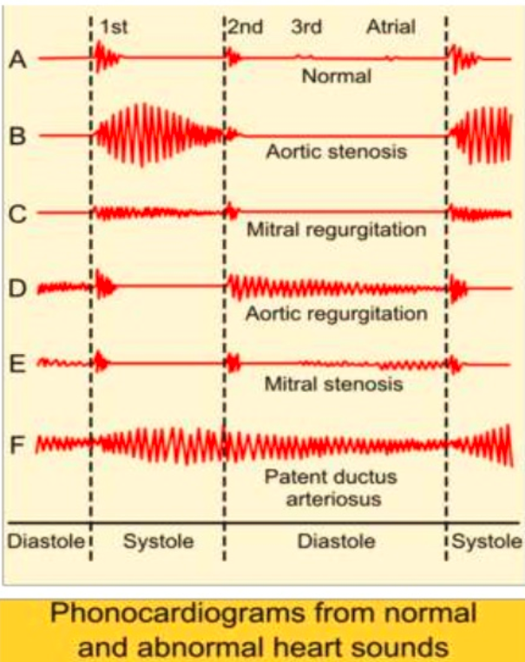
Normal and abnormal heartsounds
Abnormal sounds consisting of clicking, rushing, or gurgling noise that are either heard before, between, or after the normal heart sounds.

Slide 6
Advanced techniques for PCG analysis – 1.
Data Pre-processing :
  Resampling: 1000 Hz
  3rd order bandpass filter: 20-400 Hz
  Heart sound detection - Springer algorithm
Features extraction:
  Time-domain analysis :
    HRV analysis: pNN50, SDNN, RMSSD, mean S1&S2 width
  Frequency-domain analysis :
    DFT: Systole and diastole
    Mean amplitude ratio: A(sys)/A(dia)
  Time and frequency domain analysis:
    Wavelet decomposition
Training and classification:
  SVM

Slide 7
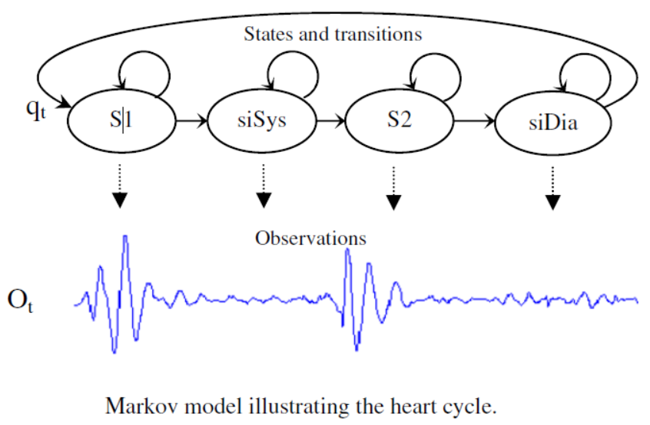
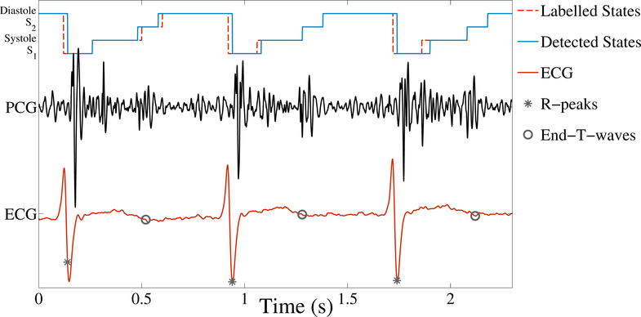
Advanced techniques for PCG analysis – 2.
Data Pre-processing: Heart sound detection - Springer algorithm

Slide 8
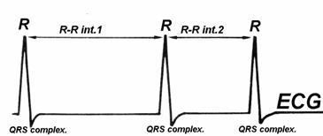
Advanced techniques for PCG analysis – 3.
Features extraction: pNN50
Ratio between NN50 and the total number of NN intervals

Slide 9
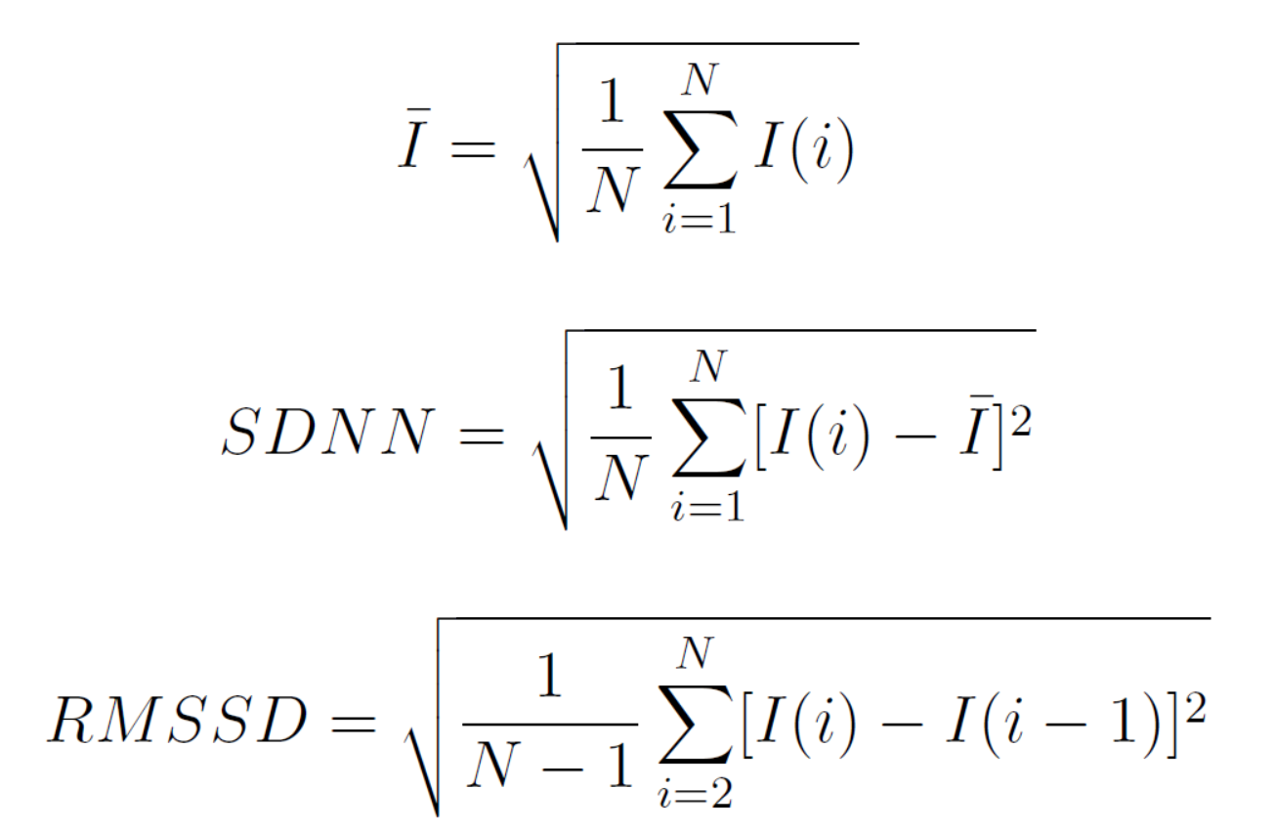
Advanced techniques for PCG analysis – 3.
Features extraction: SDNN and RMSSD

Slide 10
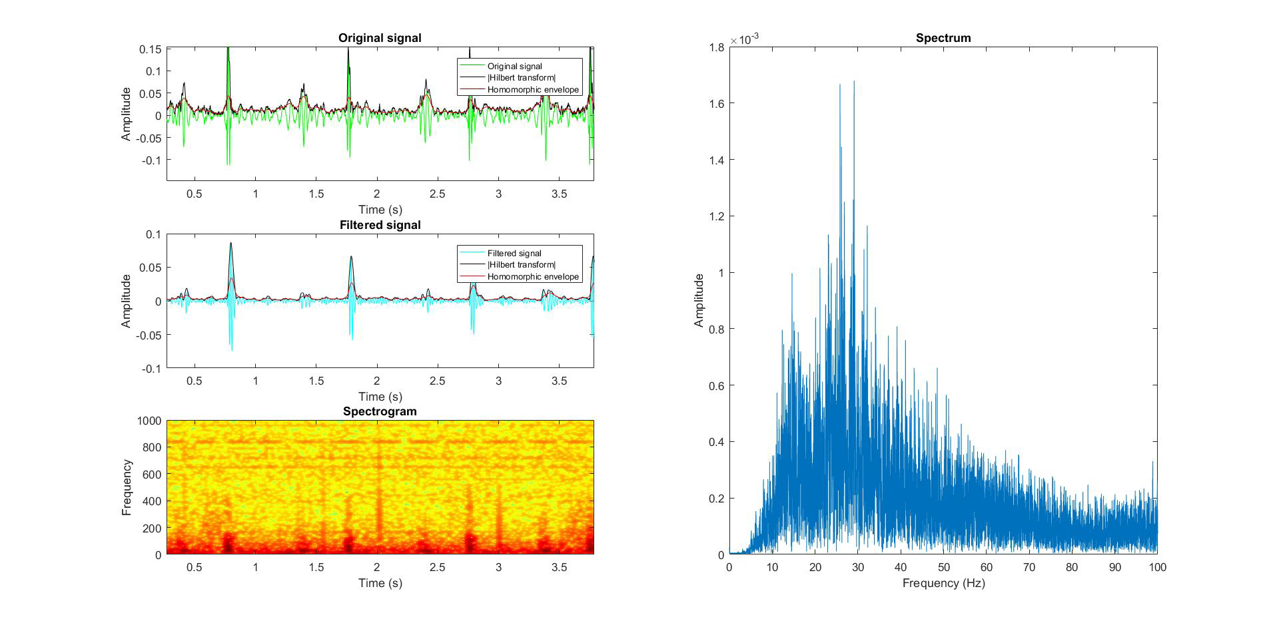
Advanced techniques for PCG analysis – 4.
Frequency-domain analysis 1.:

Slide 11
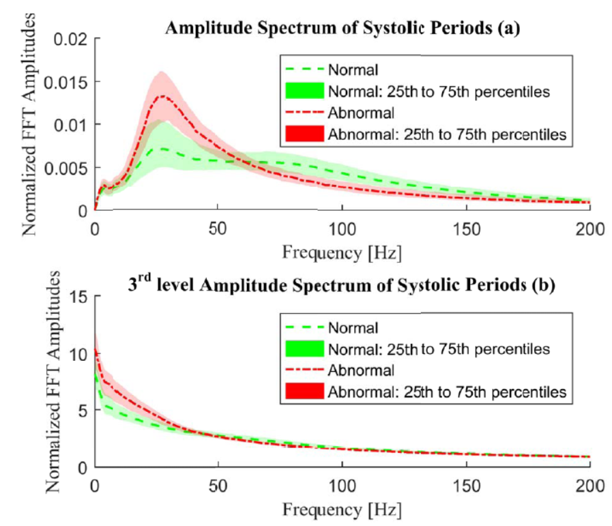
Advanced techniques for PCG analysis – 5.
Frequency-domain analysis 2.:
Mean amplitude spectral statistics for the training database. The central line represents the median of the frequency bins, while the darkened area refers to a range of 25th to 75th percentiles of the bins.

Slide 12
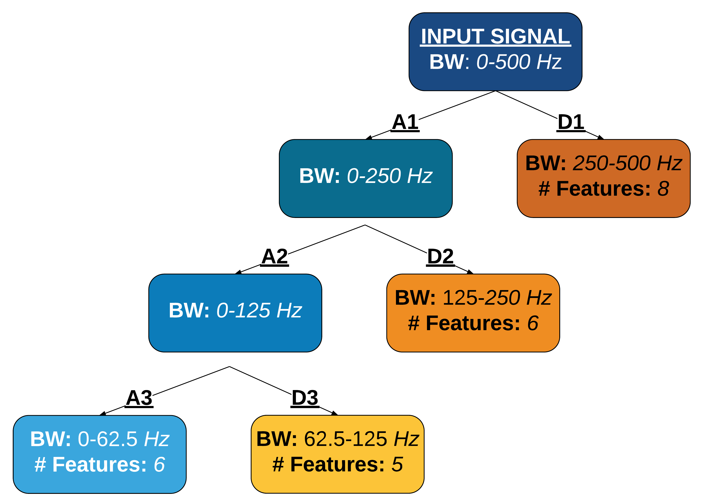
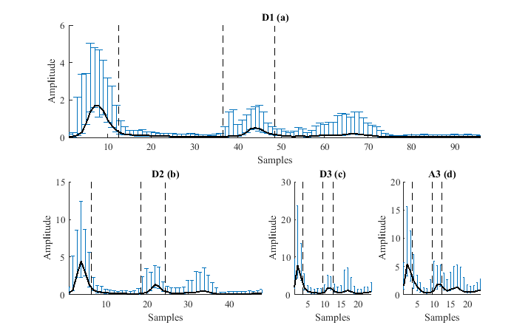
Advanced techniques for PCG analysis – 6.
Time and frequency domain analysis:

Slide 13
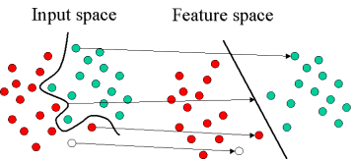
Advanced techniques for PCG analysis – 6.
Training and classification: SVM

