Slide 1
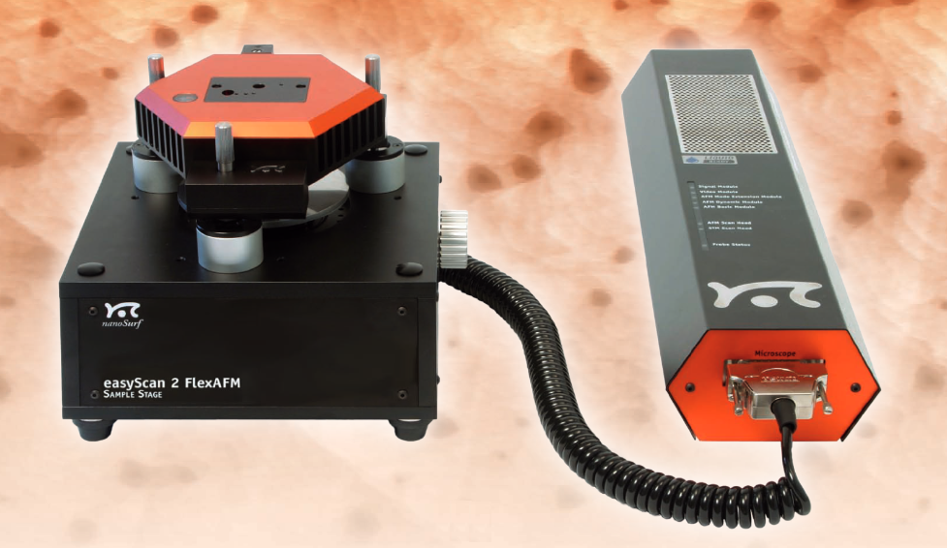

Training on AFM
Pázmány Péter Catholic Univeristy, Biomicrofluidics Laboratory

Slide 2
Informations, requirements
Website:
https://wiki.itk.ppke.hu/twiki/bin/view/PPKE/AFMesSTMgyakorlat
Subject description and requirements:
https://wiki.itk.ppke.hu/twiki/pub/PPKE/AFMesSTMgyakorlat/afm_es_stm_tantargykovetelmeny_es_laboratorium_szabalyzat.pdf
Laboratory regulation:
https://wiki.itk.ppke.hu/twiki/pub/PPKE/AFMesSTMgyakorlat/biomikrofluidika-laboratorium-szabalyzata.pdf
Availabilities:
Dr. Iván Kristóf – ivan.kristof@itk.ppke.hu
Dr. Laki András József – laki.andras.jozsef@itk.ppke.hu
Szélig Ádám György – szelig.adam.gyorgy@itk.ppke.hu
Szűcs Mihály – szucs.mihaly@itk.ppke.hu
Hartdégen Márton – hartdegen.marton@itk.ppke.hu
Pázmány Péter Catholic Univeristy, Biomicrofluidics Laboratory

Slide 3
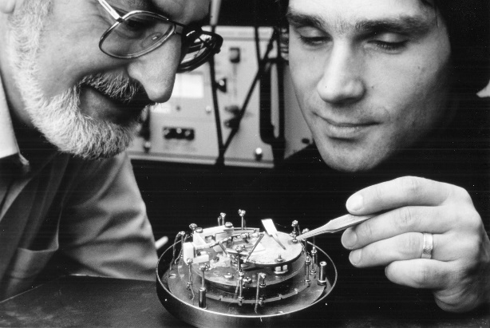
Introduction
1981 Gerd Binnig, Heinrich Rohrer - IBM Zürich - 1981 stable tunnel current - 1982 imaging
1981-1986 Scanning Probe Microcope (SPM)
1986 Nobel Prize in Physics – Scanning Tunnelling Microcsope (STM)
1986 Gerd Binnig, Quate and Gerber – Atomic Force Microscope (AFM)
Pázmány Péter Catholic Univeristy, Biomicrofluidics Laboratory
Notes:
Pásztázó mikroszkópia

Slide 4
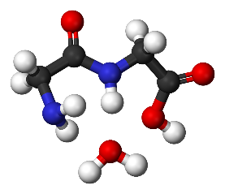
Interactions between atoms I.
Chemical bond – attraction between atoms
Ionic bond – electrostatic interaction between atoms which have a large electronegativity difference
Covalent bond – the electronegativity difference between the bonded atoms is small or nonexistent (most organic compounds are covalent)
Single and multiple bonds – sharing of one or two pair of
electrons – sigma and pi bond
Metallic bonding – bonding electrons are delocalized over a lattice of atoms
Intermolecular bonding
Pázmány Péter Catholic Univeristy, Biomicrofluidics Laboratory
Notes:
Sum : intramolecular forces
Metallic – special type of covalent bonding

Slide 5
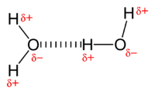
Intermolecular forces I.
Forces of attraction or repulsion which act between neighboring particles
Hydrogen Bonds: attraction between the ione pair of an electronegative atom and hydrogen atom that is bonded to either N, O or F.
Van der Waals forces
Pázmány Péter Catholic Univeristy, Biomicrofluidics Laboratory
Notes:
Flourine F

Slide 6
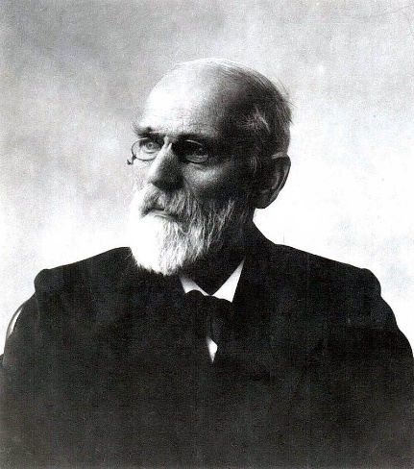
Intermolecular forces II.
Van der Waals forces: the residual attractive or repulsive forces between molecules or atomic groups that do not arise from a covalent bond, or electrostatic interaction of ions or of ionic groups with one another or with neutral molecules
Keesom interaction: electrostatic inter-actions between charges, dipoles, quadropoles and permanent multipoles
Debye force: induction (polarization) arising from interactions between rotating dipoles and from the polarizability of atoms and molecules
London dispersion force: arises due to the non-zero instantaneous dipole moments of all atoms and molecules
Pázmány Péter Catholic Univeristy, Biomicrofluidics Laboratory
Johannes Diderik van der Waals
(1837 –1923)
Notes:
http://www.tankonyvtar.hu/hu/tartalom/tkt/szerves-kemia-szerves/ch02s05.html
First, second … contributions
Dipole-dipole interactions: electrostatic interactions between permanent dipoles in molecules.
Ion-dipole and ion-induced dipole forces: involve ions, instead of only polar and non -polar molecules
Van der Waals forces are the residual attractive or repulsive forces between molecules or atomic groups that do not arise from a covalent bond, or electrostatic interaction of ions or of ionic groups with one another or with neutral molecules. The resulting van der Waals forces can be attractive or repulsive.

Slide 7
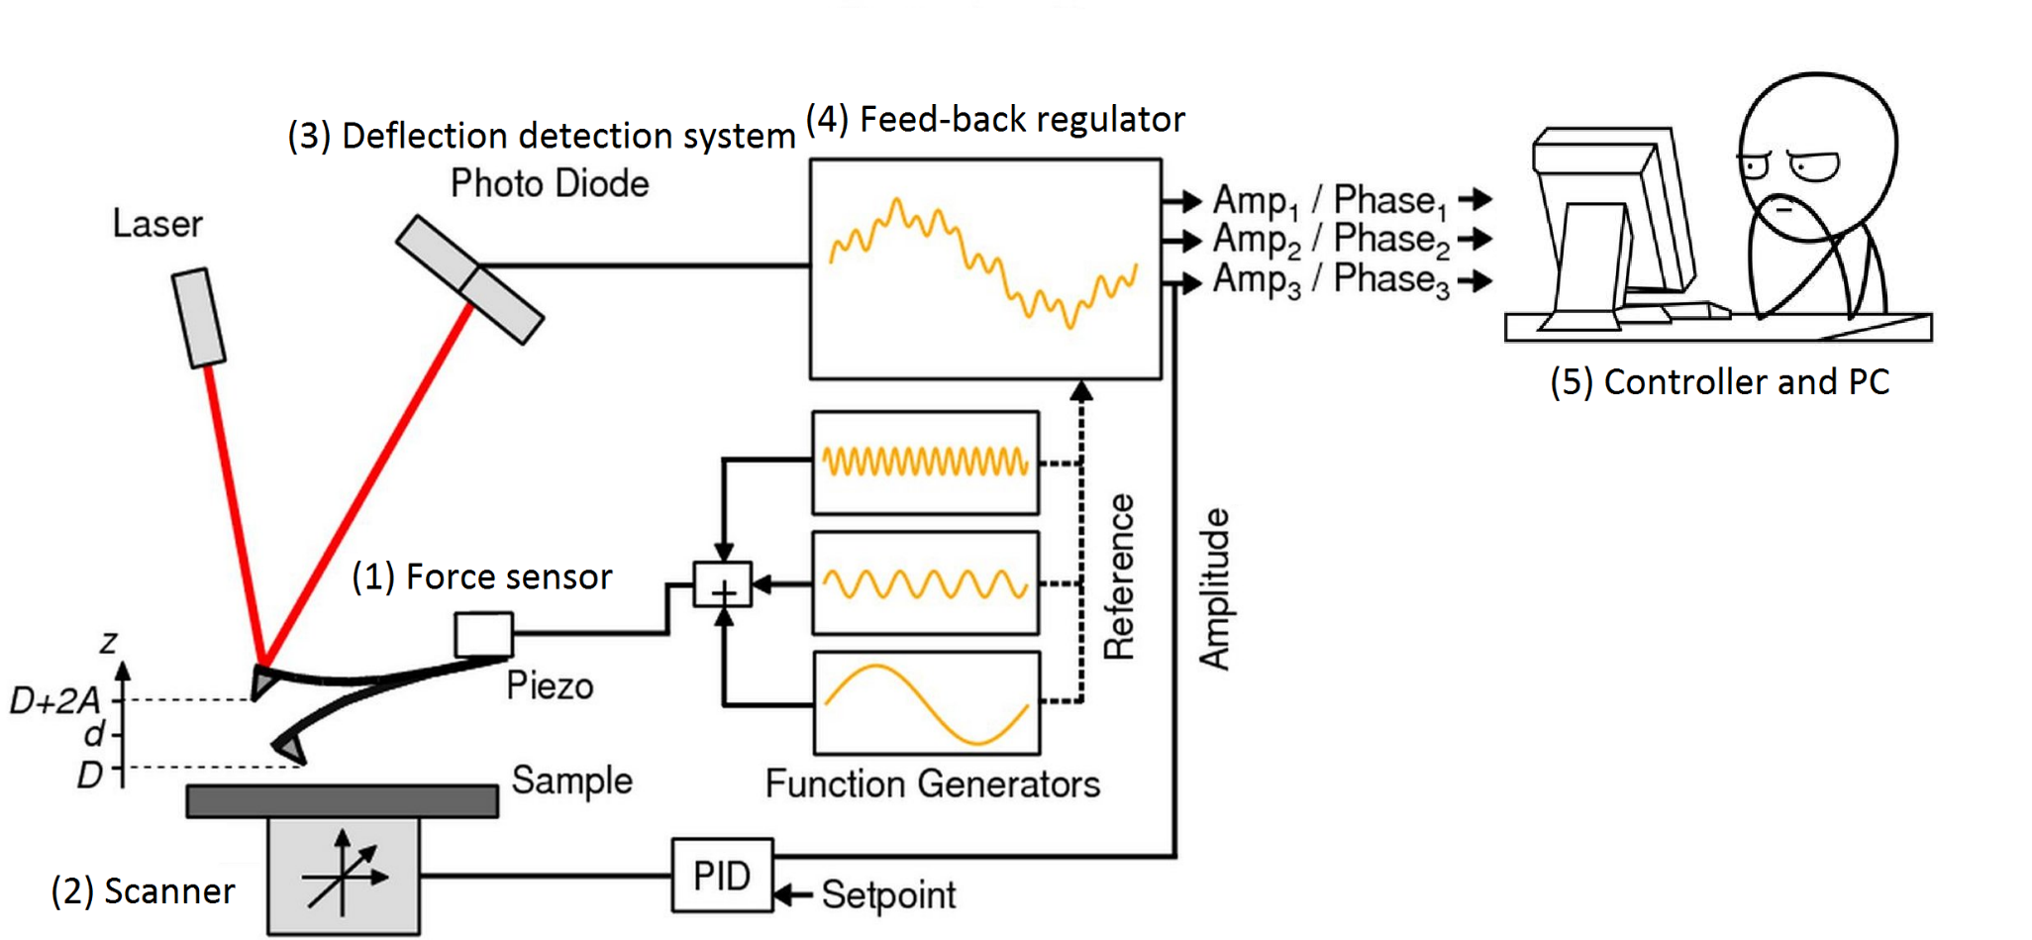
AFM Setup
Pázmány Péter Catholic Univeristy, Biomicrofluidics Laboratory
The schematic illustration of the AFM and the five components of an AFM setup

Slide 8
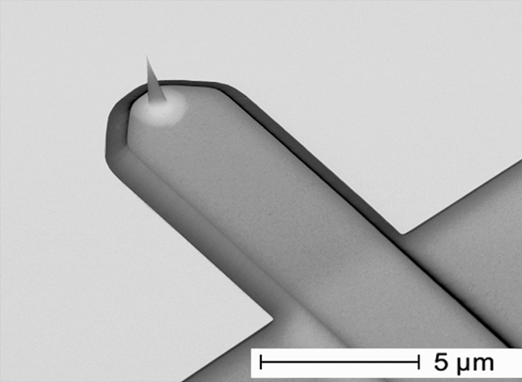
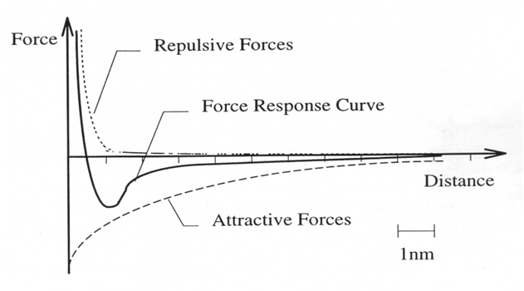
AFM Setup – 1. Force sensor
Single-leg or V-shaped canti-levers
Silicon, silicon-dioxide or silicone nitride
Several hundred micrometers long, several tens of micrometers wide and around one micrometer thick
Resonance frequencies bet-ween 10 and 100 kHz
Ideal tip: high aspect ratio, small radius of curvature, made of an extremely hard material
Van der Waals forces
Pázmány Péter Catholic Univeristy, Biomicrofluidics Laboratory

Slide 9
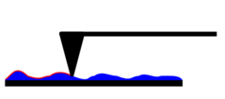
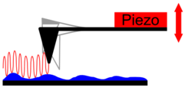
AFM Setup – 2. Scanning system
Contact or static mode:
static signal - deflection of the cantilever detected
using the feed-back signal the cantilever kept at constant position
Dynamic or tapping mode:
Cantilever oscillate up and down at or near its resonance frequency
Amplitude greather than 10 nm (100-200 nm)
As the tip gets closer to the sample, the amplitude of the oscillation will increase, then decrease.
Frequency modulation mode:
The cantilever oscillated at its resonant frequency or above (amplitude modulation)
Amplitude less than 10 nm
Van der Waals – strongest from 1 nm to 10 nm – decrease the resonance frequency of the cantilever
Pázmány Péter Catholic Univeristy, Biomicrofluidics Laboratory

Slide 10
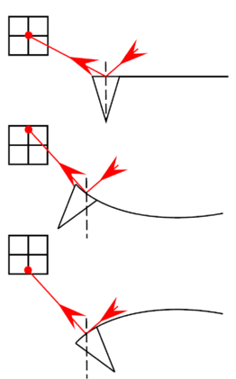
AFM Setup – 3. Deflection system
Critical part – measure the deflection of the cantilever with angstrom resolution
Optical/laser technique based systems
The laser beam focused on the very end of the cantilever – reflects back on a segmented photo diode
External perturbation – ideal distance between photo diode and the cantilever
Pázmány Péter Catholic Univeristy, Biomicrofluidics Laboratory
Cantilever deflection
Notes:
Interferometric optical system
Piezoresistive detection

Slide 11
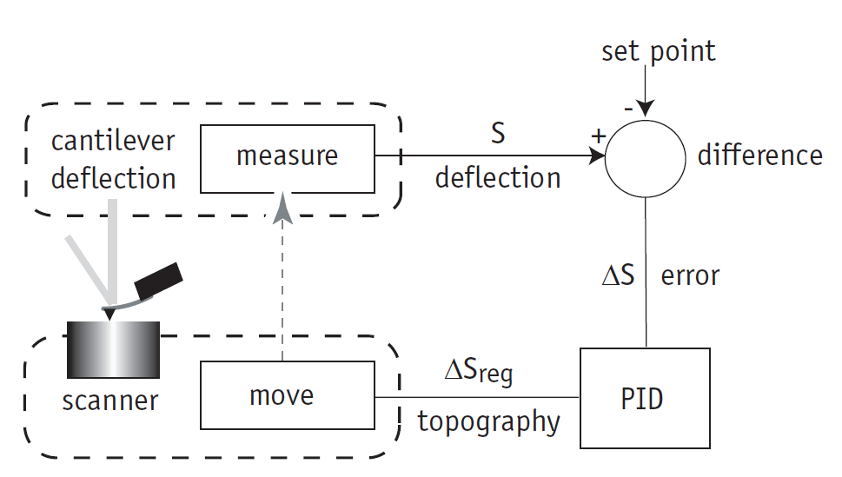
AFM Setup – 4. Feed-back system
Contact mode
Constant value of the tip-sample interaction force
Setpoint – Newton (N)
Difference between the actual interaction force and the desired force is called the error signal (∆S)
The aim: minimize the error in a very fast manner
Pázmány Péter Catholic Univeristy, Biomicrofluidics Laboratory
PID controller – control loop feedback mechanism
Proportional: accounts for present values of the error – if the error is large and positive, the control variable will be large and negative Integral: accounts for past values of error
Differential: accounts for possible future values of the error – based on its current rate of change
The three gains can be set individually
Notes:
https://en.wikipedia.org/wiki/PID_controller

Slide 12
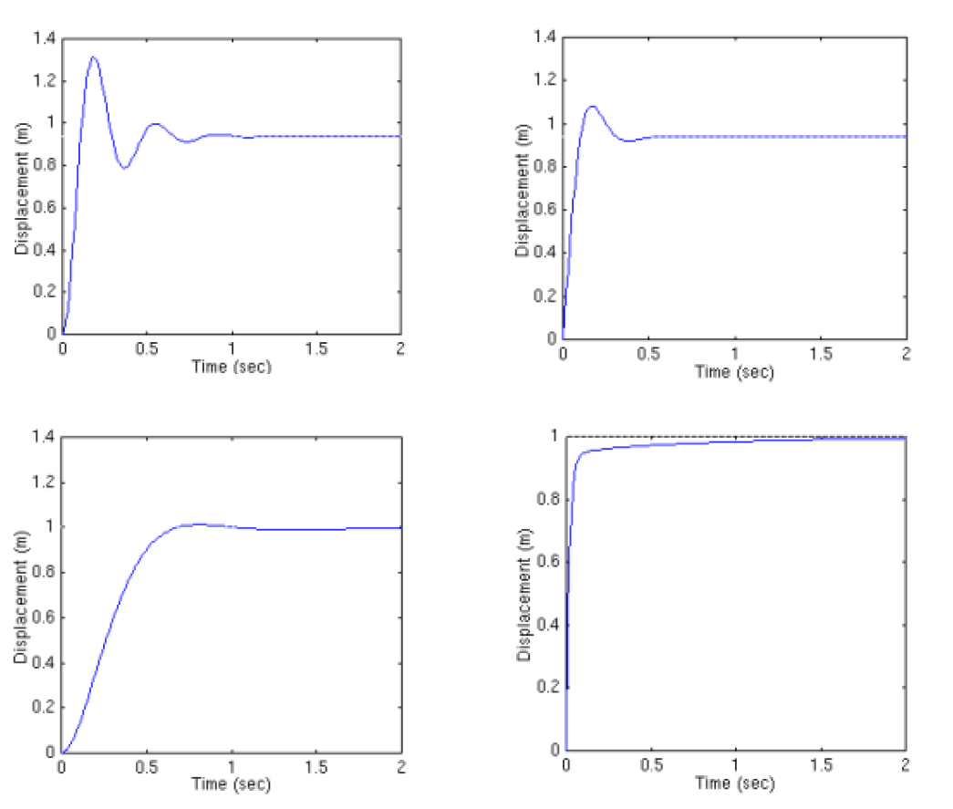
AFM Setup – 5. Controller and PC
(a)
(b)
Pázmány Péter Catholic Univeristy, Biomicrofluidics Laboratory
(c)
(d)
(a) P-Gain (b) PD-Gain (c) PI-Gain (d) PID-Gain
Notes:
(d) – different scale!

Slide 13
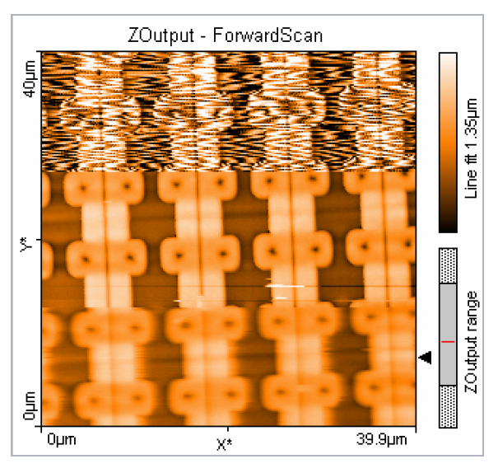
Artefacts I.
Pázmány Péter Catholic Univeristy, Biomicrofluidics Laboratory
RAM chip structure imaged at different integral gain settings: in the lowest region of the image the gain is to low; at the center, it is optimized; at the top, it is too high

Slide 14
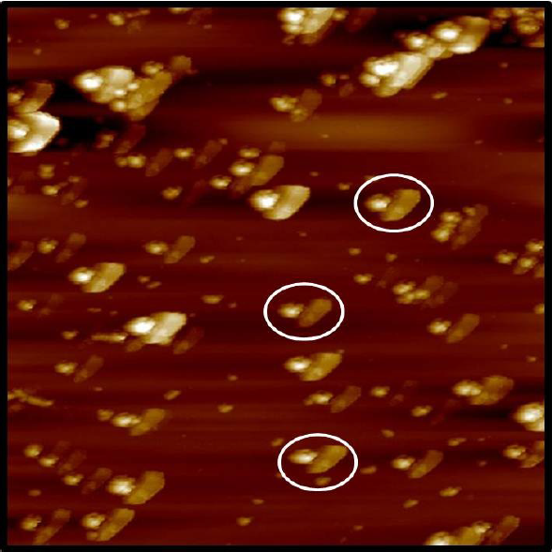
Artefacts II.
Pázmány Péter Catholic Univeristy, Biomicrofluidics Laboratory
Broken or rounded tip
The size of the thip is greather than the objects in the surface
Periodical repeating samples – easy to detect

Slide 15
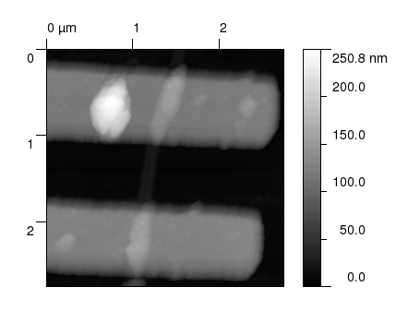
Artefacts III.
Pázmány Péter Catholic Univeristy, Biomicrofluidics Laboratory
Double tips
Every object on the projected image are doubled

Slide 16
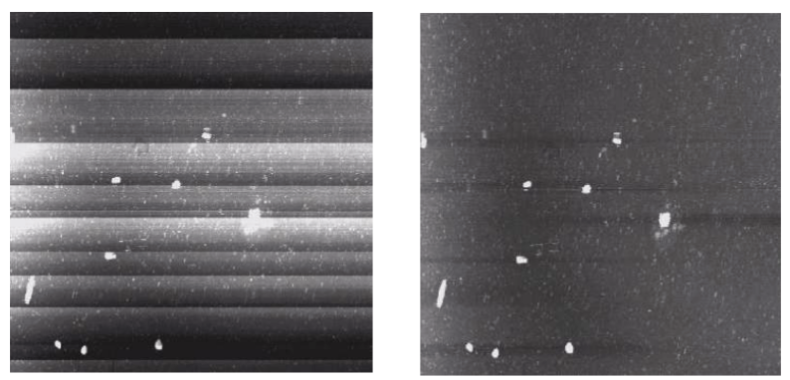
Artefacts IV.
Pázmány Péter Catholic Univeristy, Biomicrofluidics Laboratory
Line alignment
Uncertainty of head positioning causes jumping between vertical datas
Lina alignment algorithms

Slide 17
Examples
Microscopes:
Piezo Force Microscope (PFM)
Magnetic Force Microscope (MFM)
Electrostatic Scanning Force Microscope (EFM)
Imaging:
Flagellin protein
Nanoparticle masking
Contacted nanotubes
Pázmány Péter Catholic Univeristy, Biomicrofluidics Laboratory
Notes:
Piezoresponse force microscopy (PFM) is a variant of atomic force microscopy (AFM) that allows imaging and manipulation of ferroelectric domains. This is achieved by bringing a sharp conductive probe into contact with a ferroelectric surface (or piezoelectric material) and applying an alternating current (AC) bias to the probe tip in order to excite deformation of the sample through the converse piezoelectric effect (CPE). The resulting deflection of the probe cantilever is detected through standard split photodiode detector methods and then demodulated by use of a lock-in amplifier (LiA). In this way topography and ferroelectric domains can be imaged simultaneously with high resolution
The magnetic force microscope (MFM) is a variety of atomic force microscope, where a sharp magnetized tip scans a magnetic sample; the tip-sample magnetic interactions are detected and used to reconstruct the magnetic structure of the sample surface. Many kinds of magnetic interactions are measured by MFM, including magnetic dipole–dipole interaction. MFM scanning often uses non-contact AFM (NC-AFM) mode.
Electrostatic force microscopy (EFM) is a type of dynamic non-contact atomic force microscopy where the electrostatic force is probed. ("Dynamic" here means that the cantilever is oscillating and does not make contact with the sample). This force arises due to the attraction or repulsion of separated charges. It is a long-range force and can be detected 100 nm or more from the sample. For example, consider a conductive cantilever tip and sample which are separated a distance z usually by a vacuum. A bias voltage between tip and sample is applied by an external battery forming a capacitor, C, between the two. The capacitance of the system depends on the geometry of the tip and sample.

Slide 18
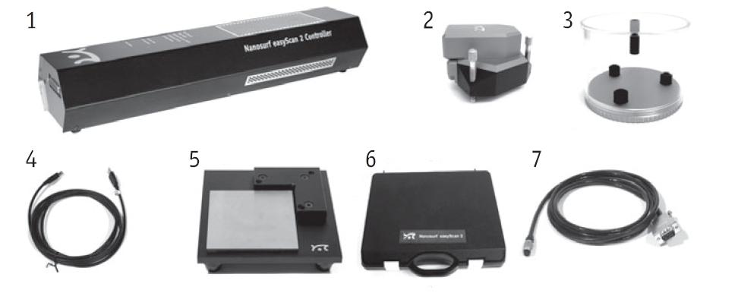
Nanosurf Easyscan AFM
Components of the system
Pázmány Péter Catholic Univeristy, Biomicrofluidics Laboratory
1. The Easyscan 2 Controller 2. Easyscan 2 AFM Scan Head
3. Scan Head Case 4. USB cable
5. Easyscan 2 AFM Sample Stage 6. AFM Tool set
7. Video camera cable

Slide 19
Nanosurf Easyscan AFM
Parameters
70 µm x-y range
14 µm z range
1.1 nm lateral resolution
0.21 nm vertical resolution
Virtually infinite sample size
Top (12x) optics
Lateral (10x) optics
Pázmány Péter Catholic Univeristy, Biomicrofluidics Laboratory

Slide 20
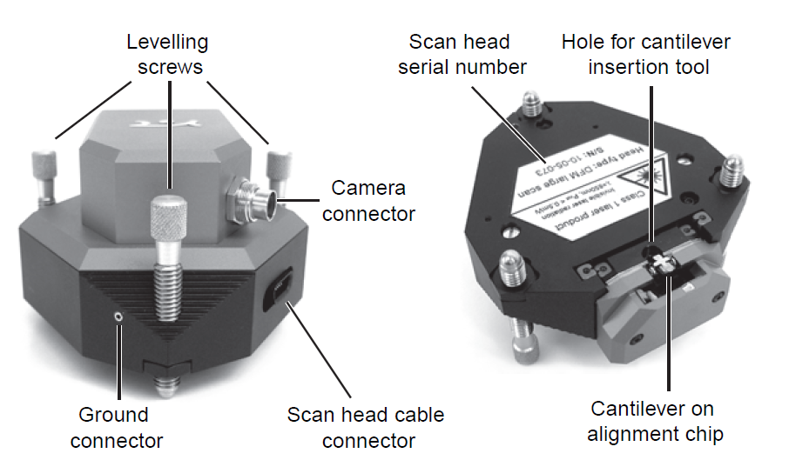
Nanosurf Easyscan AFM
Parts of the scan head
Pázmány Péter Catholic Univeristy, Biomicrofluidics Laboratory

Slide 21
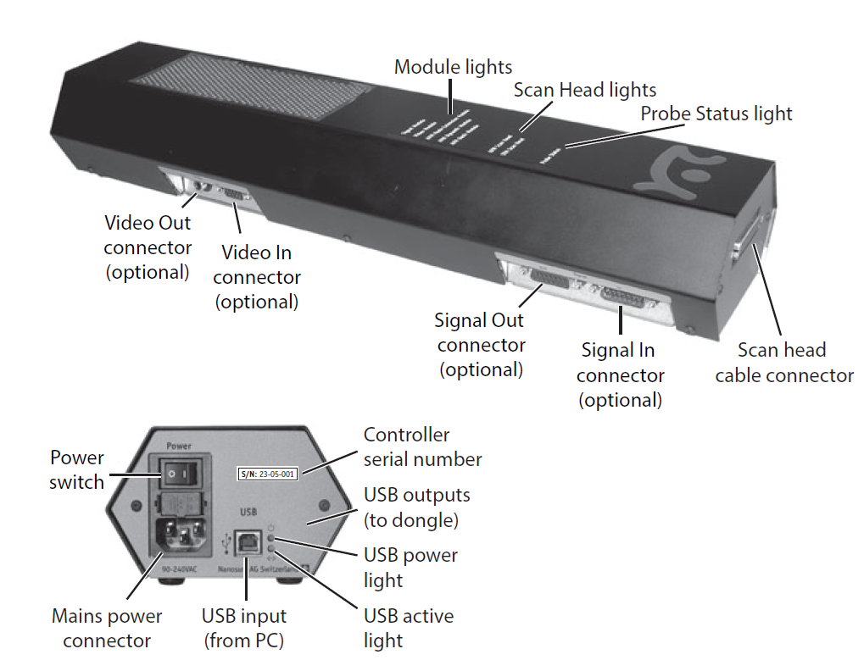
Nanosurf Easyscan AFM
The Easyscan 2 controller
Pázmány Péter Catholic Univeristy, Biomicrofluidics Laboratory

Slide 22
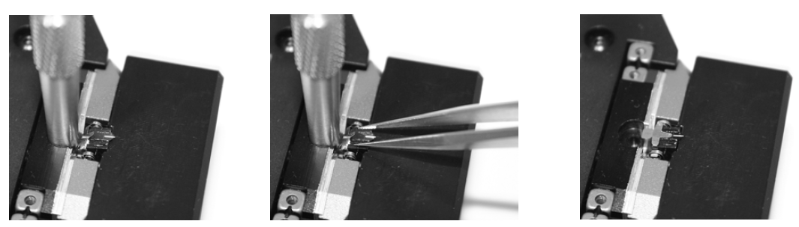
Nanosurf Easyscan AFM
Mounting the cantilever
Pázmány Péter Catholic Univeristy, Biomicrofluidics Laboratory
Left – inserting the cantilever insertion tool
Center – inserting/removing the cantilever
Right – correctly inserted cantilever

Slide 23
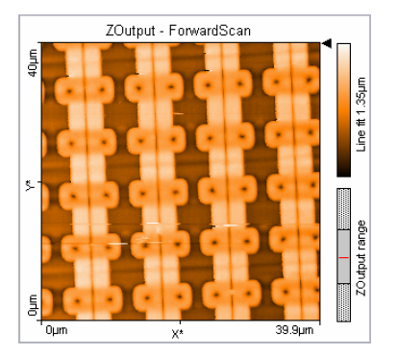
Chip structure in silicon I.
Integrated circuit (IC)
Single chip of semiconducting material (e.g. silicon)
All the functional elements (transistors, wiring and contacts) of an electronic circuit are integrated
Characterization of chips – without destroying the sample
Random Access Memory (RAM)
The structures are very regular
Ideal to understand the AFM and the PID controller
Pázmány Péter Catholic Univeristy, Biomicrofluidics Laboratory

Slide 24
Chip structure in silicon II.
Image acquisiton
Set a large scan range between 10 and 80 µm
Approach the reflective part at the center of the sample – it contains the regular structures of the chip
The height of the structure is approcimately 1 µm
Each element consists of two rounded squares, each with a hole at the center, separated by a groove – this form a memory cell
Gain settings optimization
Cleaning:
Put in ultrasonic bath - 10 minutes in distilled water - 10 minutes in alcohol - 10 minutes in propanol
Pázmány Péter Catholic Univeristy, Biomicrofluidics Laboratory

Slide 25
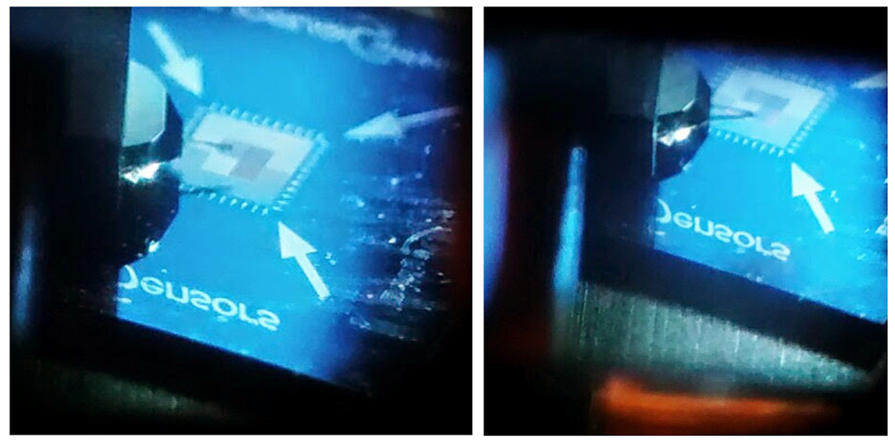
Chip structure in silicon III.
Landing on the calibration sample
Pázmány Péter Catholic Univeristy, Biomicrofluidics Laboratory

Slide 26
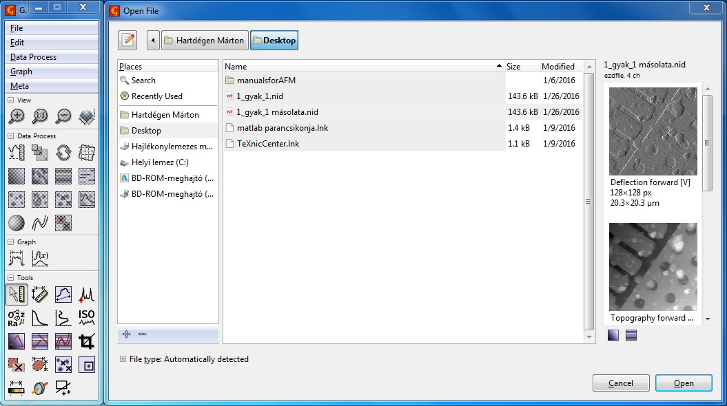
Gwyddion I.
Main window
Pázmány Péter Catholic Univeristy, Biomicrofluidics Laboratory

Slide 27
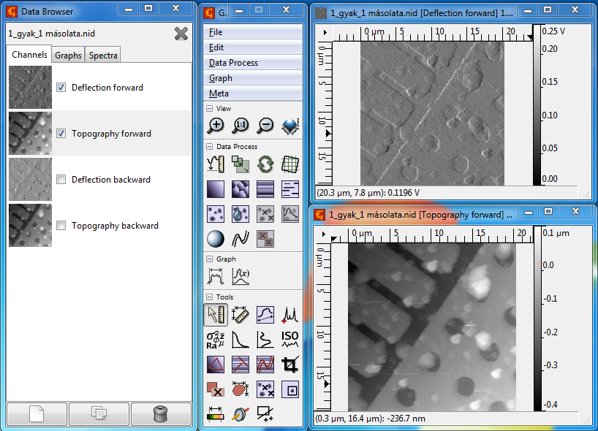
Gwyddion II.
Data Browser
Pázmány Péter Catholic Univeristy, Biomicrofluidics Laboratory
Notes:
Data Browser:
Meta-> Show Data Browser -> you can select the appropriate channel: Deflection/Topography forward/backward

Slide 28

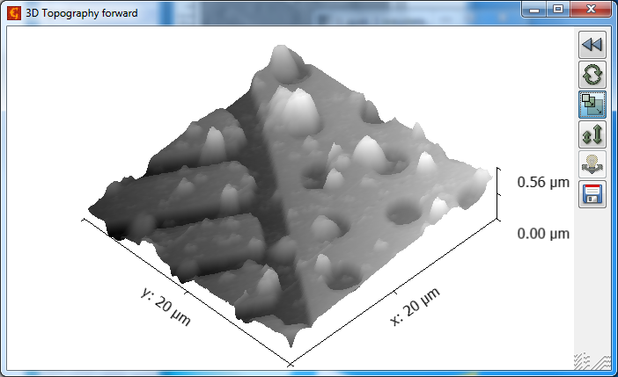
Gwyddion III.
View
Zoom in
Zoom 1:1
Zoom out
Display a 3D view of data
3D Topography forward
Pázmány Péter Catholic Univeristy, Biomicrofluidics Laboratory
Notes:
Mouse - right

Slide 29
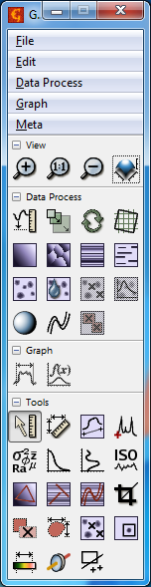
Gwyddion IV.
Data Process
Shift minimum data value to zero
Scale data
Rotate by arbitrary angle
Automatically correct rotation in horizontal plane
Level data, corrections
Mark grains, remove grains
Shading, polynomial background, interpolate data
Graph
Fit critical dimension
Fit a function on a graph data
Pázmány Péter Catholic Univeristy, Biomicrofluidics Laboratory

Slide 30
Gwyddion V.
Tools I.
Read value under mouse cursor
Measure distances and directions between points
Extract profiles
Extract and view point spectroscopy data
Statistical quantities
Calculate 1D statistical functions
Calculate row/column statistical functions
Calculate roughness parameters
Level data by fitting plane through three points
Level rows using intersections with given lines
Level X or Y lines with polynomials
Crop data
Pázmány Péter Catholic Univeristy, Biomicrofluidics Laboratory

Slide 31
Gwyddion VI.
Tools II.
Edit mask
Measure individual grains (continious parts of mask)
Remove individual grains (continious parts of mask)
Interpolate smart defects, manually selected
Stretch color range to part of data
Basic filters
Display and copy selections
Pázmány Péter Catholic Univeristy, Biomicrofluidics Laboratory

Slide 32
CD/DVD I.
Physical details I.
120 millimeters (4.7 inch) diameter
700 MiB of data (80 minutes of uncompressed audio)
James T. Russell, 1966 – first system to record digital information on an optical transparent foil that is lit from behind a high-power halogen lamp -> Sony/Philips 1980s
Made from 1.2 millimeters thick polycarbonate plastic
Thin layer of aluminium is applied to the surface – making it reflective
CD data is represented as tiny identations – pits, encoded in a spiral track moulded into the top of the polycarbonate layer
Areas between pits = lands
Pit: 100 nm deep, 500 nm wide and varies from 850 to 3500 nm long
Pitch: distance between the tracks (CD: 1600 nm DVD: 740 nm)
Pázmány Péter Catholic Univeristy, Biomicrofluidics Laboratory

Slide 33
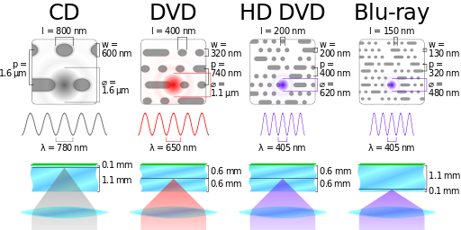
CD/DVD II.
Comparison CD, DVD, HD DVD and Blu-ray
Pázmány Péter Catholic Univeristy, Biomicrofluidics Laboratory

Slide 34
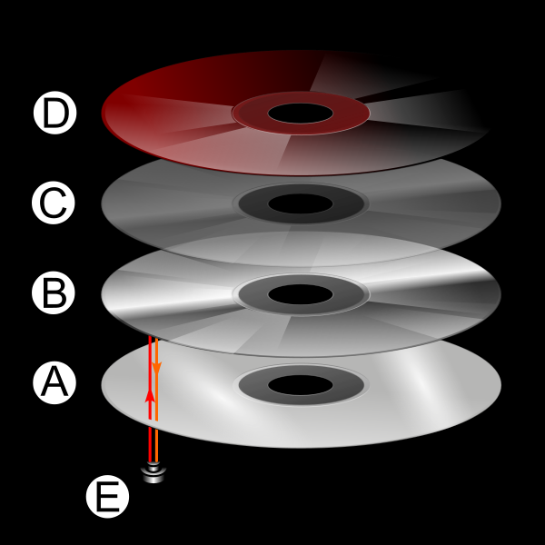
CD/DVD III.
Diagram of CD layers
A: Polycarbonate dics layer has the data encoded by using bumps
B: A shiny layer reflects the laser
C: A layer of lacquer protects the shiny layer
D: Artwork is screen printed on the top of the disc
E: A laser beam reads the CD and is reflected back to a sensor, which converts it into electronic data
Pázmány Péter Catholic Univeristy, Biomicrofluidics Laboratory

Slide 35
CD/DVD IV.
Physical details II.
Motor – spins the disc to 1.2-1.4 m/s (500 RPM – inside, 200 RPM outside edge)
Program area is 86.25 cm²
The length of the recordable spiral is 5.38 km
Read: focusing a 780 nm wavelength semiconductor laser (DVD 650 nm)
The change in height between pits and lands results in a difference in the way the light is reflected
Measuring the intensity change with a photodiode
Non-return-to-zero, inverted encoding is used
Eight-to-fourteen modulation
Pázmány Péter Catholic Univeristy, Biomicrofluidics Laboratory
Notes:
86.05 cm2/1.6 um = 5,38 km
Using a linear velocity of 1.2 m/s and a narrower track pitch of 1.5 µm increases the playing time to 80 minutes, and data capacity to 700 MiB.
The pits and lands themselves do not directly represent the zeros and ones of binary data. Instead non-return-to-zero, inverted encoding is used: a change from pit to land or land to pit indicates a one, while no change indicates a series of zeros. There must be at least two and no more than ten zeros between each one, which is defined by the length of the pit.
Az EFM eljárás, azaz 8-ból 14 bitet adó kódmoduláció azon alapszik, hogy a 8 bittel leírható 256 kódkombináció helyett elvi kombinációs lehetõség nyílik. Ennyire nyilván nincs szükség, ezért ezek közül kiválasztották azokat, amelyek kódjában a szomszédos zérusok darabszáma kettõnél több, de tíznél kevesebb. Ennek a feltételnek csupán 267 kódszó felel meg, ami még mindig 11-gyel több, mint amennyire (256) szükség van.
Így viszont csupa olyan kódszóval lehet a 256-féle adatot stb. leírni, amelyekben garantált idõhatárok között mindig van 1-0 vagy 0-1 átmenet, vagyis NRZ (Non Return to Zero: zérusra nem visszatérõ) kóddal lehetséges a lemezre írás. Ez utóbbi viszont számos elõnnyel jár: egyszerû az órajel visszanyerése, kisebb a szomszédos szimbólumok egymásra hatásának veszélye, és így lehet egyszerûen biztosítani a már említett egyenáramú és kisfrekvenciás összetevõk elnyomását, ami a lejátszó szervorendszerében jelent egyszerûsödést.
Az EFM eljárásban, mint láttuk, 267-féle kódvariáció maradt. Ha ebbõl további 11-et elvetünk, akkor a megmaradó 256 éppen a kívánt darabszám, vagyis egy ROM-ban a kívánt kódalakzatok egyszerûen tárolhatók, így az átalakítás 8-ról 14-re vagy 14-rõl 8-ra egyszerûen megoldható.
Végezetül még egy gondolat a hibajavításról. A CIRC hibajavító kód hatásossága igen nagy, de szükség is van rá, mert a CD lemezek visszajátszásánál két fõ okból is elõfordulhat hiba. Az egyik hibaok az, hogy a gyártásban a lemez esetleg hibásan készült el, a másik, amely a lemez felületét ért sérülésekbõl származik. Mindkettõvel szemben jelentõs védelmet biztosít a CIRC. Így például 3500 bit meghibásodása (megfelel a hanglemezen kb. 2,4 mm-nek) még teljesen javítható, sõt, ha interpolációs hibajavítást is alkalmaz a dekódoló, akkor a maximális zavarzóna hosszúság 12 000 bit (!) is lehet, ami a lemezen mintegy 8,5 mm úthossznak felel meg. Ezért aztán érthetõ, ha a reklámszövegek arról írnak, hogy a digitális hanglemezek teljesen érzéketlenek az ujjlenyomatokra, karcolásokra, felületi szennyezõdésekre stb. Valóban igazak ezek az állítások, amirõl bárki meggyõzõdhet, ha egy digitális hanglemezre kísérletképpen nem átlátszó, vékony papírcsíkot ragaszt fel, és megpróbálja a lemezt így lejátszani.

Slide 36
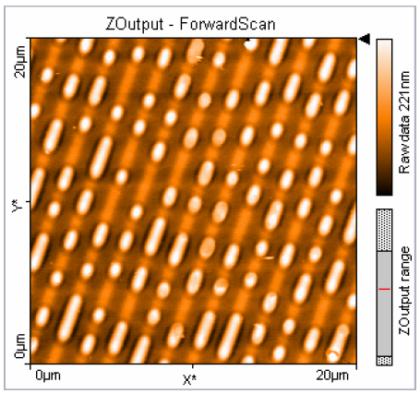
CD/DVD V.
20 µm image of CD Stamper
Pázmány Péter Catholic Univeristy, Biomicrofluidics Laboratory

